Slide 1
FACULTY DIVERSITY PROGRAM
March 22, 2022

Slide 2
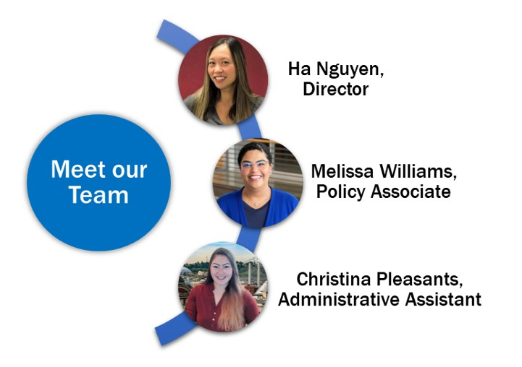
The Equity, Diversity, and Inclusion Team
SBCTC:
Julie Huss, Director of Human Resources
Claudine Richardson, Student Success Center Policy Associate
Notes:
Ha and team; would also like to introduce our state board colleagues, Julie Huss, HR director, and Dr. Claudine Richardson, policy associate with the student success team.

Slide 3
Land Acknowledgement
SBCTC acknowledges that our community resides on the ancestral lands of the First Peoples. The office of the Washington State Board for Community and Technical Colleges is located in Olympia on the Coast Salish lands of the Nisqually, Cowlitz, and Squaxin peoples.
We ask you to join us in celebrating the Indigenous Tribes of Washington by acknowledging their ancestral lands, their communities, and the past, present, and future generations of the Native Peoples across our good state.
Notes:
Melissa

Slide 4
Labor Acknowledgement
We also acknowledge that our nation and our institutions have benefited and profited from the free enslaved labor of Black people. We recognize the entangled and interconnected histories of Indigenous peoples who were forcibly removed from their land and the plight of the Black people who were forcibly brought to it. We acknowledge the enduring impacts of the African diaspora and lift up the contributions, talents, and dreams of Black communities.
Importantly, we also acknowledge the immigrant and refugee labor that has contributed to the building of this country within our labor force, including voluntary, involuntary, trafficked, and undocumented peoples. We recognize and honor their important contributions to our good state and to this nation.
Notes:
Melissa

Slide 5
Faculty Diversity Program
Develop a model faculty diversity program designed to provide for the retention and recruitment of faculty from all racial, ethnic, and cultural backgrounds. Must be based on proven practices in diversity hiring.
Faculty Diversity Model Template
Notes:
Quick overview:
As many of you are aware and may have attended our Jan EDI info sessions,
E2SB 5194, Section 3(1) outlines the requirement that all community and technical colleges must submit, on a biennial basis, strategic plans to the state board for community and technical colleges for achieving diversity, equity, and inclusion of all races on their campuses. Included in Section 3(5) is the requirement for the state board for community and technical colleges (SBCTC) to develop a model faculty diversity program designed to provide for the retention and recruitment of faculty from all racial, ethnic, and cultural backgrounds. The faculty diversity program must also be based on proven practices in diversity hiring processes.
EMPHASIZE collaborative work with HR, “The EDI and HR teams at SBCTC worked to develop guidance to support colleges as they develop their own faculty diversity program.
The faculty diversity model template intends to provide colleges a blueprint to assist with the development of their faculty diversity program, a key component in their DEI Strategic Plans as outlined in Section 3, E2SSB 5194. The template also includes elements of the Workforce Diversity Plan submitted by each college in December 2020 per Workforce Diversity Directive - State HR Directive 20-02.

Slide 6
Directive 20-02
All state agencies and higher education institutions must develop or update their workforce diversity plans
Submitted to State Human Resources by December 2020
Notes:
Julie
Workforce Diversity Directive - State HR Directive 20-02. The faculty diversity program template gives colleges the opportunity to build on their current efforts for diversifying faculty as detailed in their workforce diversity plans and assists in highlighting areas for consideration.

Slide 7
AREAS TO CONSIDER
Review of policies and procedures that support diversity, equity, and inclusion, e.g. hiring practices, DEI professional development allocations, affinity groups, etc.
Implicit bias training
Review of racial and ethnic data of current faculty
Leadership involvement in policy reviews and implementation
Demographic data reviews of applicant and interviewee pools
Workforce development needs of Highly Underrepresented (HU) communities
Notes:
Julie

Slide 8
Intersections with Guided Pathways
Dr. Claudine Richardson Student Success Center Policy Associate, SBCTC

Slide 9
College Highlights
Highline College: Summer Korst
Pierce College-Fort Steilacoom: Ilder Betancourt-Lopez
Spokane Falls Community College: Bonnie Glantz
Notes:
Ha

Slide 10
HIGHLINE COLLEGE
Summer Korst
Executive Director of Human Resources
Highline College
skorst@highline.edu

Slide 11
HIGHLINE COLLEGE PRACTICES
Bias Literacy Training - includes best practices for equity-minded recruitments and implicit bias discussions
NeoGov - assess and monitor demographic data
SparkHire - one-way video interview system
Canvas courses - build a new course using content from Bias Literacy Training
Notes:
How Faculty Hiring Committees Reproduce Whiteness (SA “homework”): https://drive.google.com/file/d/1JWwOK0TMQ1y4iCRuXc-ZZMyrRzX7arGD/view?usp=sharing

Slide 12
PIERCE DISTRICTS
Ilder Betancourt-Lopez
Vice President of Learning and Student Success
Pierce College – Fort Steilacoom
IBetancourtLopez@pierce.ctc.edu

Slide 13
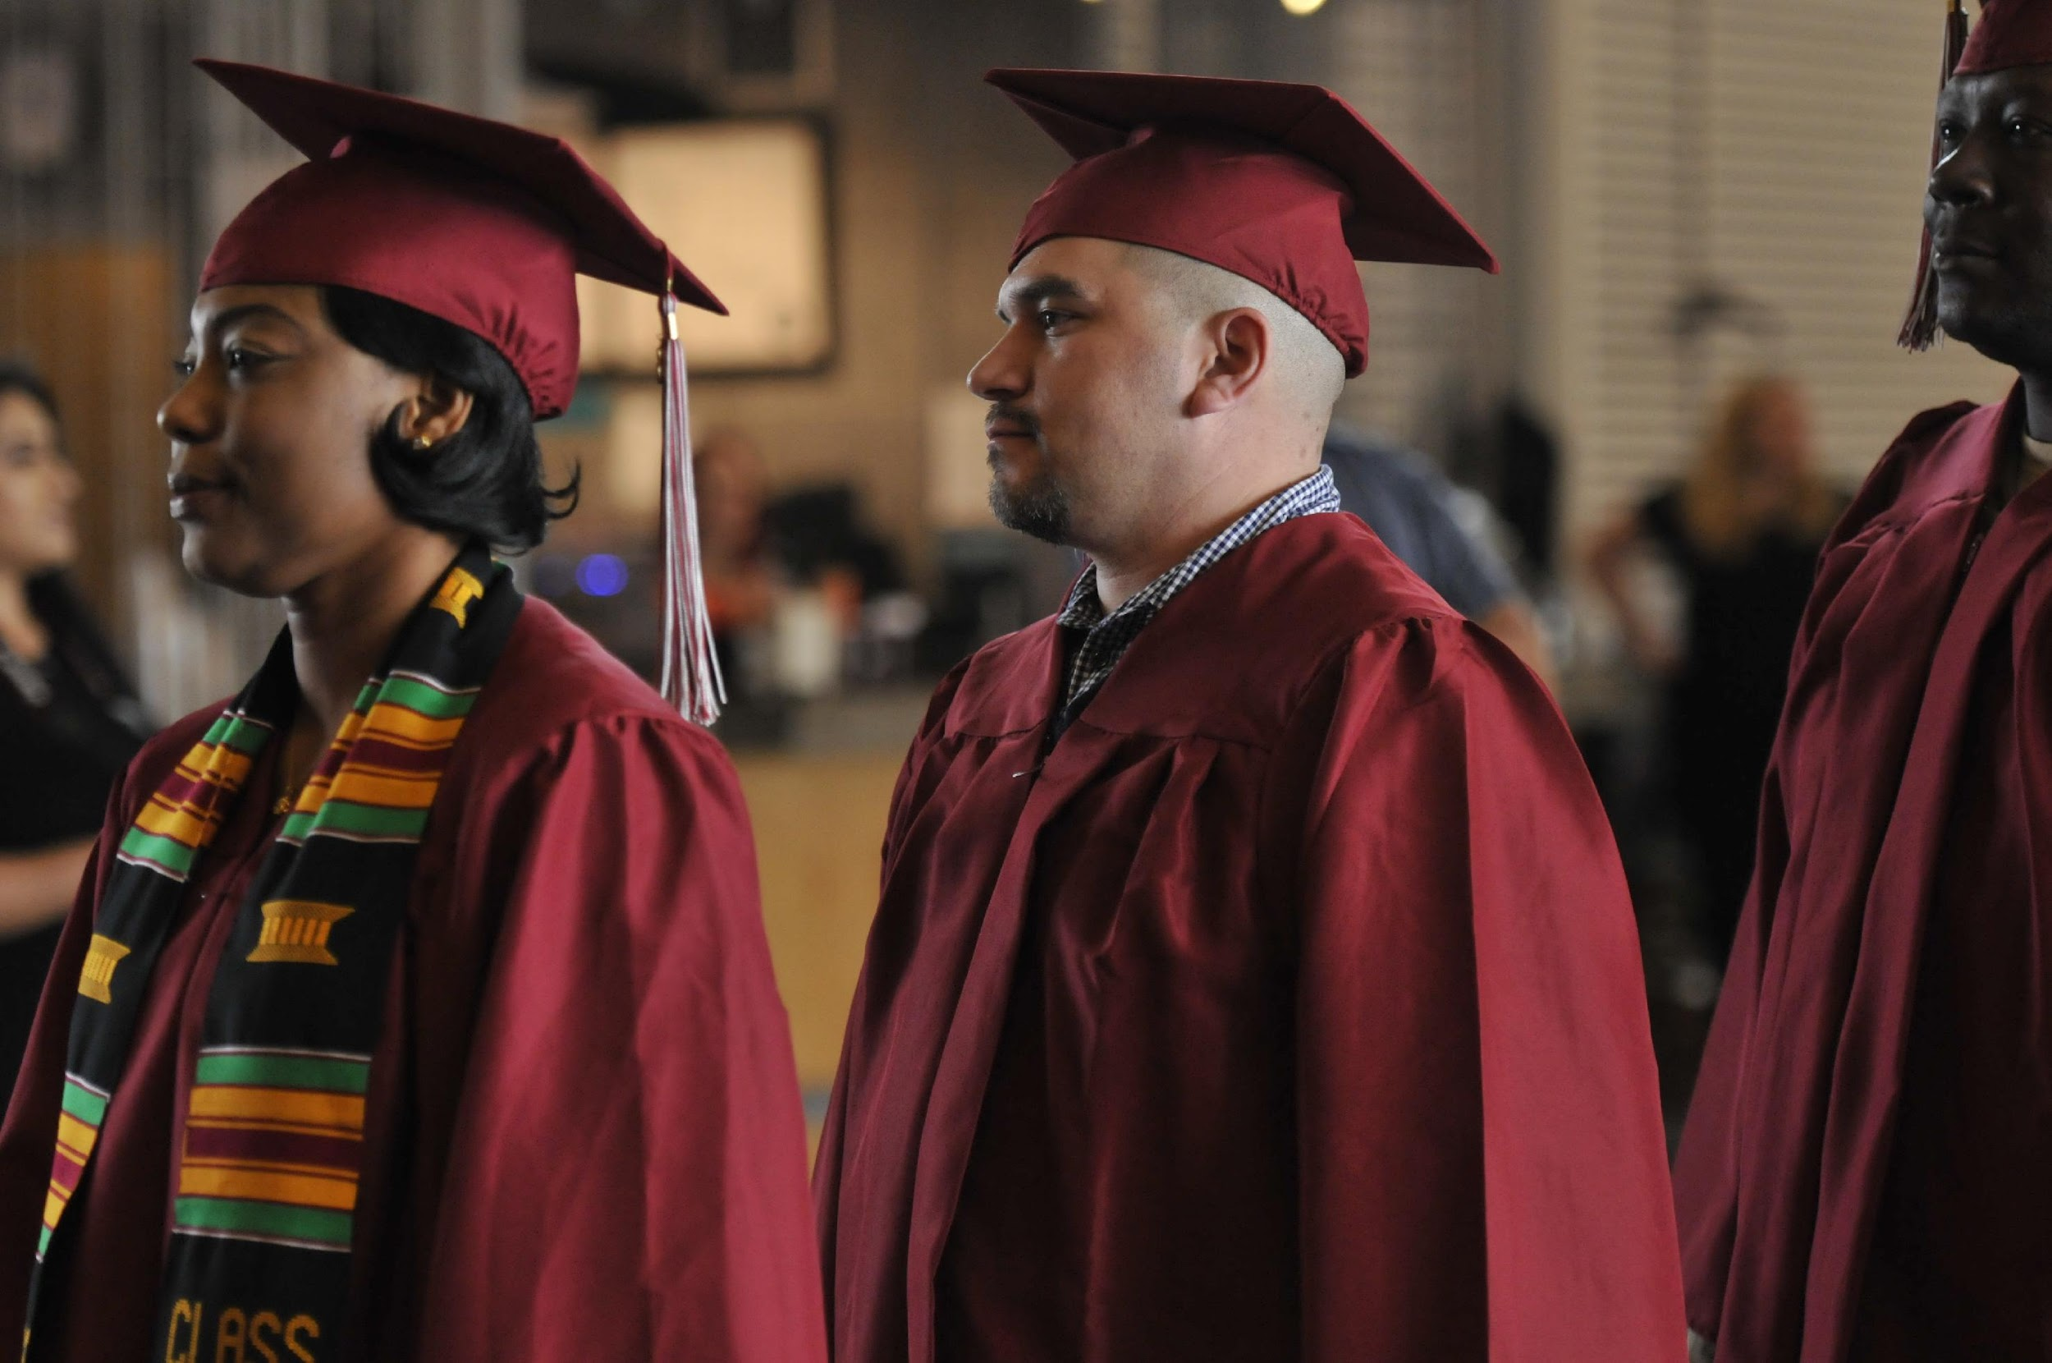
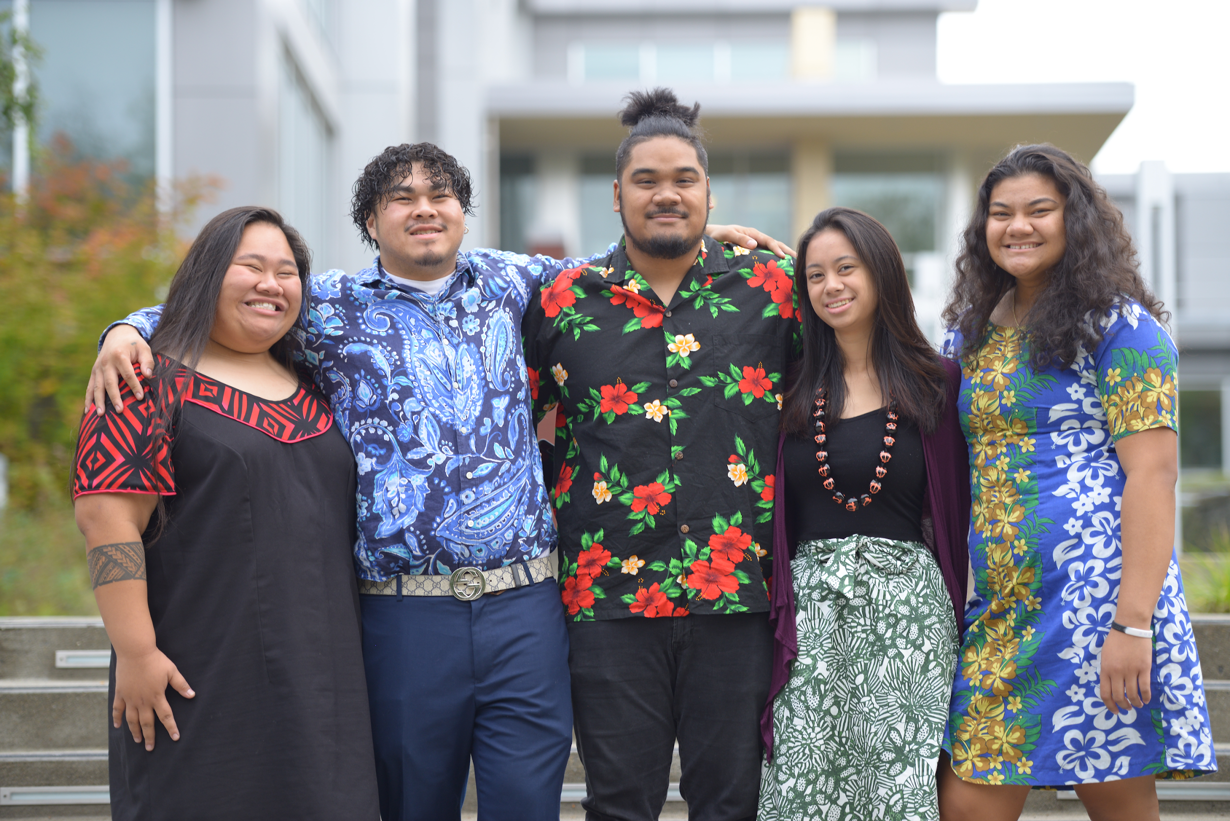
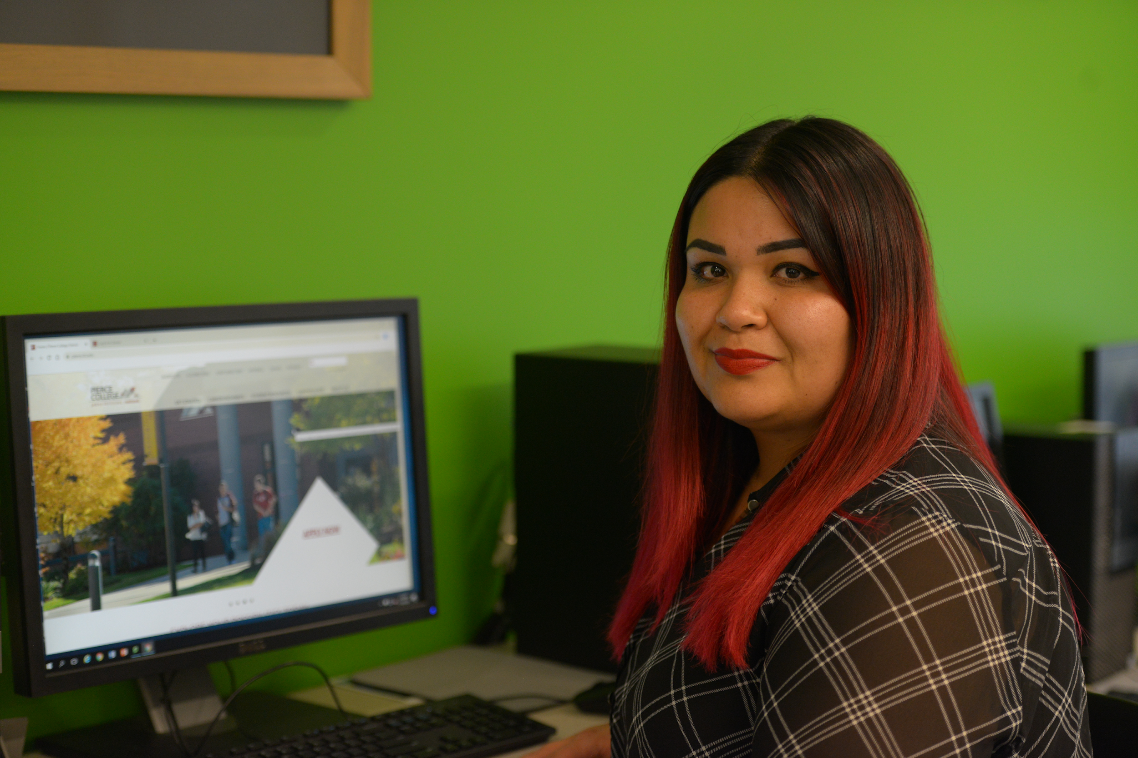
Focus on Racial Equity in Faculty Hiring

Slide 14
Racial Equity in Faculty Hiring
Hiring
Process
First-Year
Faculty Cohort
Tenure Process

Slide 15
Racial Equity in Faculty Hiring
Cluster Hires Approach
Hiring
Process
First-Year
Faculty Cohort
Tenure Process

Slide 16
Racial Equity in Faculty Hiring
Cluster Hires Approach
https://www.pierce.ctc.edu/hr-faculty-cluster-hire
Job Description
Hiring
Process
First-Year
Faculty Cohort
Tenure Process

Slide 17
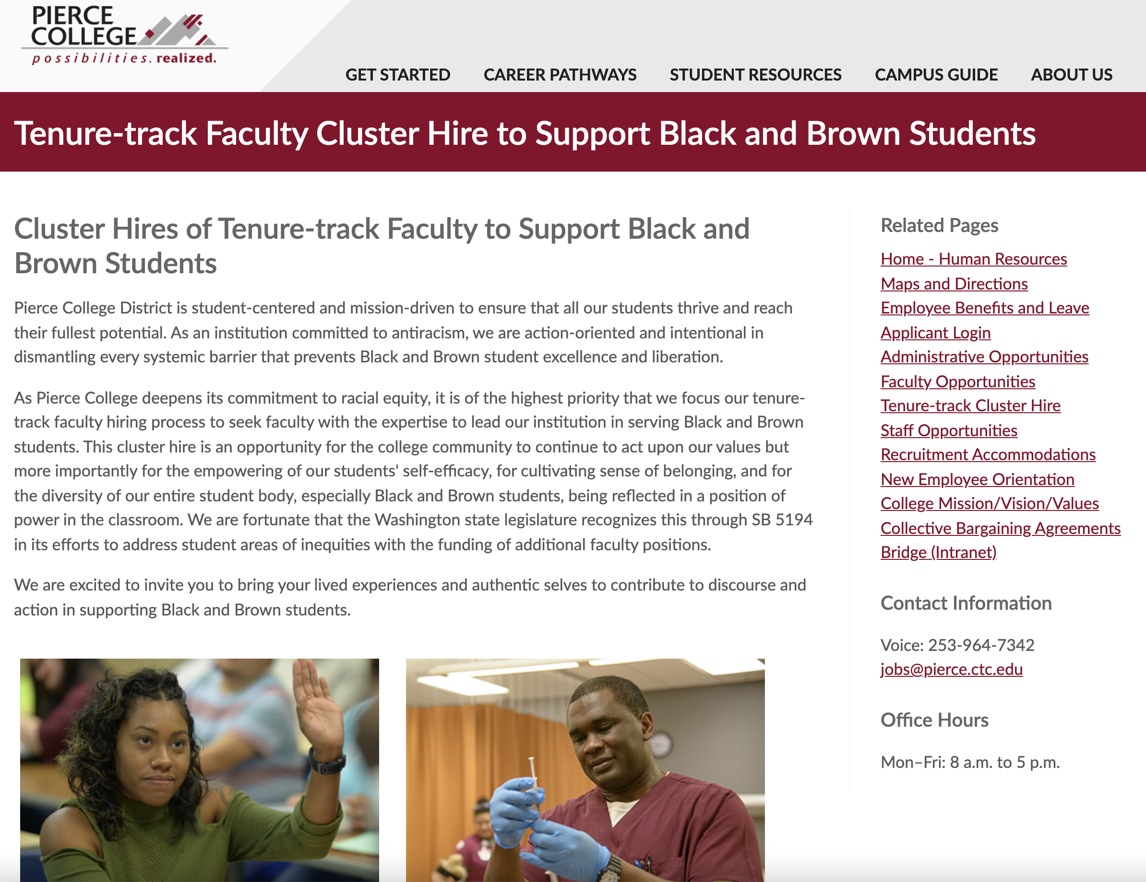
Racial Equity in Faculty Hiring
Cluster Hires Approach
Job Description
Hiring
Process
First-Year
Faculty Cohort
Tenure Process

Slide 18
Racial Equity in Faculty Hiring
Cluster Hires Approach
Job Description
Hiring
Process
First-Year
Faculty Cohort
Tenure Process

Slide 19
Racial Equity in Faculty Hiring
Cluster Hires Approach
Discuss and rank
Job Description
Score five variables
% BIPOC Student Enrollment
% BIPOC Student Success
% BIPOC Faculty
Adjunct Faculty
Faculty Hire Criteria
Deans identify faculty needs
Total Enrollment
Hiring
Process
First-Year
Faculty Cohort
Tenure Process

Slide 20
Refocus on Black and Brown student excellence
Hiring
Process
First-Year
Faculty Cohort
Tenure Process

Slide 21
SPOKANE DISTRICTS
Bonnie Glantz
Dean, Visual & Performing Arts
Spokane Falls Community College
Bonnie.Glantz@sfcc.spokane.edu

Slide 22
Search Advocates at Community Colleges of Spokane
“Do the best you can until you know better. Then when you know better, do better.”
Maya Angelou
Adapted from OSU’s Search Advocates Program

Slide 23
How We Knew We Needed Search Advocates

Slide 24
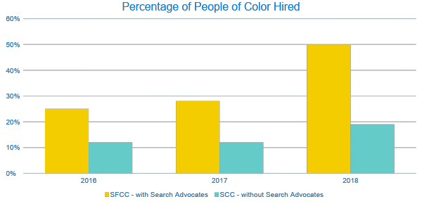
The Impact of Using Search Advocates

Slide 25
What is a Search Advocate (SA)?
A non-voting member of the screening committee who has been trained in practices that interrupt bias and enhance equity and inclusion in the hiring process.
A Search Advocate serves as a partner and resource to the committee, assisting them to achieve their goal of a conducting a fair, equitable, and inclusive search.

Slide 26
Search & Selection Process
Structural Bias
Develop Position
Establish Criteria
Recruit
Screen
Interview
References
Select
Integrate
Cognitive Bias
What is the Search Advocate's role?
Adapted from OSU’s Search Advocates Program

Slide 27
Search Advocate Mission
To enhance
in our searches
Validity
Equity
Diversity
© 2009-2022 Oregon State University. All rights reserved.

Slide 28
Search Advocate Actions
To attend to the process (vs. content)
To assist the committee members to test their thinking so as to interrupt cognitive bias
To recommend best practices that mitigate structural bias
© 2009-2022 Oregon State University. All rights reserved.

Slide 29
Search Advocate – Committee Chair: an essential partnership
Relationship between chair and Search Advocate is one of a partnership in mutually supportive roles
Functions best when there is mutual respect and trust, open and honest communication

Slide 30
Search Advocate Workshop Agenda
Objectives
Case Study
Search Advocate Role, Mission, & Actions
Legal Overview
Equity, Diversity, & Inclusion
Unconscious Bias
Group & Power Dynamics
Search Stages & Search Advocate strategies
Adapted from OSU’s Search Advocates Program

Slide 31
Objectives: At the end of this workshop, you will be able to…
Describe the role of the search advocate in the search/selection process;
Give one or more definitions of diversity, equity, and inclusion;
Explain how cognitive bias and structural bias differ, and describe the connections between them;
Identify typical ways that searches fail to mitigate bias; identify how power dynamics can interfere with a fair process.
Develop a screening criteria rubric that will increase inclusion and reduce bias;
Recommend practices that increase inclusion, reduce bias and mitigate power dynamics in all stages of the screening process, from the development of the position description to integration of the new employee.
Adapted from OSU’s Search Advocates Program

Slide 32
Training Format
Short lectures alternating with…
Guided exercises in breakout sessions with the same team members throughout the day
Quizzes to check for comprehension
“Readers Theatre” style sketches to illustrate typical scenarios and how a Search Advocate could intervene

Slide 33
Screening Criteria Rubric: “The Matrix”
Qualification​ | Required or​ Preferred​ | Relationship to job​ | Screening criteria​ | Transferable?​ | Stage to Assess | Priority
​ ​ | ​ | ​ | ​ | ​ | ​ | ​
​ | ​ | ​ | ​ | ​ | ​ | ​
​ | ​ | ​ | ​ | ​ | ​ | ​
​ | ​ | ​ | ​ | ​ | ​ | ​
​ | ​ | ​ | ​ | ​ | ​ | ​
​ | ​ | ​ | ​ | ​ | ​ | ​
​ | ​ | ​ | ​ | ​ | ​ | ​
​ | ​ | ​ | ​ | ​ | ​ | ​
© 2009-2022 Oregon State University. All rights reserved.

Slide 34
THE MATRIX: Relationship to Job
How is it used on the job?
Why do they need it?
What parts of the position require it?
What would be difficult or impossible without it?
Is it a proxy for a specific set of skills? If so, how can we state the skills directly?
(Ensures relevance, interrupts structural bias)
© 2009-2022 Oregon State University. All rights reserved.
Notes:
BONNIE

Slide 35
ESTABLISH CRITERIA: Transferable
Is this a "portable" skill that someone could learn in one setting and use in another?
What would it look like to demonstrate this skill in a different context or setting?
(Offsets structural bias, enhances inclusion)
© 2009-2022 Oregon State University. All rights reserved.
Notes:
BONNIE

Slide 36
ESTABLISH CRITERIA: Screening Criteria
What would indicate to us that a candidate meets this qualification/competency?
How would a candidate demonstrate that they meet it?
What is another way? What else?
What would distinguish a candidate who has a higher level of this competency from one who has a lower level?
Can we think of someone who would be good at this job but won't meet this criteria? How can we expand?
(Offsets structural bias, enhances inclusion)
© 2009-2022 Oregon State University. All rights reserved.

Slide 37
ESTABLISH CRITERIA: When to Assess
At what stage(s) of the screening process will we be able to assess this?
At what stage will we eliminate those who don't meet it?
(Offset cognitive bias, increases equity)
© 2009-2022 Oregon State University. All rights reserved.

Slide 38
ESTABLISH CRITERIA: Importance/Weight
If required: How important is it to have extra strength in this qualification (compared to other required qualifications)?
If preferred: Will someone stronger in this qualification perform better on the job?
Which preferred qualifications are most and least likely to predict success on the job?
(offset cognitive bias in screening, increases equity)
© 2009-2022 Oregon State University. All rights reserved.

Slide 39
Location and Mission
Spokane Falls Community College (SFCC) is a beautiful campus located in the inland Pacific Northwest, on the ancestral home of the Spokane Tribe, near the Spokane River. Our campus is not far from the urban center of Spokane, a mid-sized city with a high quality of life and quick access to the outdoors.
SFCC is one of two accredited community colleges that comprise the Community Colleges of Spokane (CCS). In addition to serving the urban and suburban population in greater Spokane, including students from Fairchild Air Force Base, CCS provides educational services to rural communities throughout our 12,302 square-mile region in Eastern Washington, including students from the Spokane and other Eastern Washington tribes.
...SFCC endeavors to be an educational leader and a responsive partner with the community and region to provide access to relevant programs of the highest quality... As reflected in our mission statement, we strive to “embrace diversity, promote equity, and foster global awareness” at every level of our college.

Slide 40
Leadership/Training Team
Guillermo Espinosa
Director of Student Success, Equity, and Diversity
Bonnie Glantz
Instructional Dean,
Visual & Performing Arts
Angela Rasmussen
English Faculty
Director of the Teaching and Learning Center
Macki Snyder
Human Resources
Lori Hunt
Acting Provost
Grace Leaf
Acting CIO

Slide 41
QUESTIONS?

Slide 42
SUPPORTING RESOURCES
Faculty Diversity Model Template
SBCTC Faculty Diversity Model Program
DEHPD- 17 Steps in the Hiring Process
Washington State Research Action Plan to Dismantle Systematic Injustices & Racism
OSU Search Advocate Program

Slide 43
ADDITIONAL RESOURCES
The additional resources listed below may help develop the agency's diversity plan.
Workforce Diversity Directive - State HR Directive 20-02
Washington Law Against Discrimination
Title VII of the Civil Rights Act
Executive Order 12-02 on Workforce Diversity and Inclusion
Executive Order 13-02 on Improving Employment Opportunities & Outcomes for People with Disabilities in State Employment
Executive Order 16-05 on Building Safe Communities Through Successful Reentry
Executive Order 19-01 on Veteran and Military Family Transition and Readiness Support
Employer of Choice Committee publication on Unconscious Bias in Hiring
Measuring Diversity webpage from OFM State HR
Veteran Employment Plan
HRMS Data Definitions Resource Guide
Affirmative Action and Demographic Data Guide
Human Resources Management Report
RCW 41.06.530 - Personnel resource and management policy—Implementation
WAC 357-01-015 – Affirmative Action Plans
Affirmative Action Laws and Rules Applicable in Washington from OFM State HR
17 Steps to Hiring
Search Advocacy

Slide 44
CONTACTS:
Ha Nguyen Director of Equity, Diversity, and Inclusion (SBCTC) hnguyen@sbctc.edu 360-704-1001 | Julie Huss Director of Human Resources (SBCTC) jhuss@sbctc.edu 360-704-4350
Pierce College- Fort Steilacoom: Ilder Betancourt-Lopez IBetancourtLopez@pierce.ctc.edu | Spokane Falls Community College: Bonnie Glantz Bonnie.Glantz@sfcc.spokane.edu
Highline College: Summer Korst skorst@highline.edu | EDI Team: edi@sbctc.edu Ha Nguyen, Melissa Williams, and Christina Pleasants

