Slide 1
E2SSB 5227 & 5194: OVERVIEW + IMPLEMENTATION
Ha Nguyen, Melissa Williams, & Christina Pleasants
Equity, Diversity, & Inclusion Department, SBCTC
January 2022

Slide 2
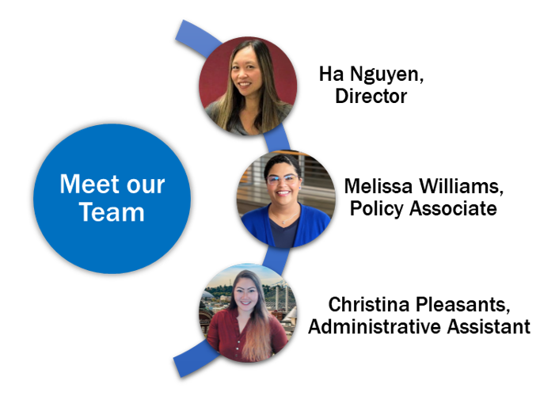
EDI Team

Slide 3
Thank you for joining us!
Please share your name, title, college and reason for joining us in the chat.
Please feel free to share your personal pronouns as well.
Please be courteous to others, and speak clearly and slowly.
Live auto-transcription will be provided in Zoom.
This presentation will be recorded and include a full transcription.
The recordings will be accessible on our NEW EDI webpage.
SBCTC is committed to providing equal access for individuals with disabilities to its programs and events in accordance with the ADA and 504 of the Rehabilitation Act.
If you have questions, please use the ‘Questions’ Google Doc
If you need any assistance, please feel free to contact Christina Pleasants.

Slide 4
Land Acknowledgment
SBCTC acknowledges that our community resides on the ancestral lands of the First Peoples. The office of the Washington State Board for Community and Technical Colleges is located in Olympia on the Coast Salish lands of the Nisqually, Cowlitz, and Squaxin peoples.
We ask you to join us in celebrating the Indigenous Tribes of Washington by acknowledging their ancestral lands, their communities, and the past, present, and future generations of the Native Peoples across our good state.
We know that such statements only become truly meaningful when coupled with authentic relationships and sustained commitment, and as such, we commit to continued efforts to build our collective understanding and action to foster authentic native community connections.

Slide 5
Labor Acknowledgment
We acknowledge that our nation (and our institutions) have benefited from the free enslaved labor of Black people. We recognize the interconnected histories of Indigenous peoples who were forcibly removed from their land and of those who were forcibly brought to it. We acknowledge the enduring impacts of the African diaspora, honor the contributions, talents, and dreams of our Black communities.
We acknowledge the immigrant labor that has contributed to the nation as a critical labor force, including voluntary, involuntary, trafficked, forced, and undocumented peoples. We recognize and honor their significant contributions.
In these acknowledgements, we commit to the essential work of moving beyond awareness to action through meaningful changes at our institutions and in our communities.

Slide 6
PURPOSE
WA State Board in highlighting Diversity and Equity Officers’ (DEOC) work and significance to EDI work
Significance of state bills to advance EDI work
Actions of our colleges

Slide 7
E2SSB 5227: Diversity in Higher Education
Campus Climate Assessments
Colleges shall each conduct a campus climate assessment every 5 years (at minimum) to understand the current state of DEI on campus for faculty, staff, and students.
Must post findings on public website.
Listening & Feedback Sessions
Colleges must conduct annual DEI listening and feedback sessions for the entire campus community.
Must compensate students for their participation and post findings on public website.
Professional Development & Training
Provide DEI/anti-racism training to faculty, staff, and students.
Create an evaluation for the participants.
Share completed evaluations and other program information with SBCTC annually.
Post DEI training framework on public website.

Slide 8
E2SSB 5194: Equity & Access in Higher Ed.
Section 3 - DEI Strategic Plans
Culturally Appropriate Student Outreach Program
Colleges must establish a culturally appropriate student outreach program to communities of color, students with disabilities, and low-income communities.
Program should assist potential students to understand opportunities available and navigate student aid.
Peer Mentoring Strategies
Colleges must include opportunities for students from minoritized communities to form student-based organizations to mentor and assist each other in navigating the educational system.
Faculty Diversity Program
Designed to provide for the retention and recruitment of faculty from all racial, ethnic, and cultural backgrounds.
Must be based on proven practices in diversity hiring processes.
DEI Definitions
Colleges must include DEI definitions in their strategic plans, reports, and public websites.

Slide 9
E2SSB 5194: Equity & Access in Higher Ed.
Section 5
Full-time Tenured Positions
Colleges must increase full-time tenured positions by 200 new full-time tenure-track positions.
Colleges should keep in mind when implementing these conversions that there was a specific intent from the legislature to have the conversions align with the college’s EDI strategic plans.
Colleges should consider utilizing their faculty diversity programming identified in their DEI strategic plan and the Guidance for Faculty conversions to inform the hiring of the 200 faculty positions.

Slide 10
Implementation Timeline
AY2021-22
AY2022-23
AY2023-24
AY2024-25
AY2025-26
AY2026-27
Conduct Campus Climate Assessment
*Publish assessment results on college website
Conduct Listening and Feedback Sessions
*Publish listening and feedback session results on college website
Conduct Listening and Feedback Sessions *Publish listening and feedback session results on college website
Conduct Listening and Feedback Sessions *Publish listening and feedback session results on college website
Conduct Listening and Feedback Sessions *Publish listening and feedback session results on college website
Conduct Campus Climate Assessment *Publish assessment results on college website
Submit DEI Strategic Plans
Provide DEI/anti-racist training for ALL new faculty and staff
Provide DEI/anti-racist training for ALL new faculty and staff * 35% of tenured faculty and administrators must complete training every 2 years
Provide DEI/anti-racist training for ALL new faculty and staff
Provide DEI/anti-racist training for ALL new faculty and staff
Provide DEI/anti-racist training for ALL new faculty and staff *80% of total faculty and staff must complete training every 2 years *Post DEI terms and training framework on college website
Prepare to add 200 new full-time tenure-track positions
Submit DEI Strategic Plans
Provide DEI/anti-racist training for all NEW degree-seeking students
Provide DEI/anti-racist training for all NEW degree-seeking students
Provide DEI/anti-racist training for ALL degree-seeking students
Create and collect program evaluations from training participants
Submit DEI Strategic Plans
Notes:
CCAs - submit progress reports or findings to SBCTC, by July 1, 2022.
DEI Plans - submit to SBCTC, July 30, 2022

Slide 11
QUESTIONS

Slide 12
SBCTC GUIDANCE + COLLEGE HIGHLIGHTS
Campus Climate Assessments
SBCTC: Summer Kenesson
Faculty Diversity Model template
SBCTC: Ha Nguyen/Julie Huss
DEI Strategic Plans
Yakima Valley College: Jeannette Quintero
DEI/Anti-racism Professional Development
Cascadia College: Chari Davenport and Samantha Brown
Clark College: Dr. Rashida Willard
Outreach/Peer Mentoring
South Puget Sound Community College: Parfait Bassalé

Slide 13
CAMPUS CLIMATE ASSESSMENTS
Senate Bill 5227 requires all colleges to conduct campus climate assessments (CCAs) and campus listening and feedback sessions.
Findings must clarify the current state of DEI in classrooms, common areas, offices and meetings, libraries and support services, and – if offered at the college – residential accommodation.
May also evaluate “prevalence of discrimination, sexual assault, harassment, and retaliation on and off campus” in addition to “student, faculty, and staff knowledge of campus policies and procedures addressing discrimination, sexual assault, harassment, and retaliation”.
Colleges should note the requirement to consult with faculty, students, DEI officers, and staff in the development or selection of an instrument
Submit findings from CCAs to the SBCTC and publish on college websites

Slide 14
SBCTC GUIDANCE
The SBCTC has conducted several consultation sessions to inform the development of a Guidance Document for the CCAs
Students and faculty of color were invited to discuss and inform the SBCTC on priorities, concerns, and expectations of the CCAs and college listening (or engagement) sessions
The Diversity and Equity Officers Commission and the Research and Planning Commission are working together through SBCTC leads
Resources for reference and updates to the Guidance document will be ongoing

Slide 15
OVERARCHING PRINCIPLES
Campus Climate Assessments should be:
Inclusive
CCAs should be selected and administered through broad college consultation, and
Administered to meet the needs of all students, faculty and staff as far as possible
Transparent
CCAs should be administered and results analyzed and published with integrity and openness
Impactful
The findings from CCA should be used to inform DEI strategic plans and professional development programs
Findings from CCAs should be a meaningful part of college improvement plans

Slide 16
OUTCOMES
Beginning July 1, 2022, colleges must submit reports of findings and/or progress on CCAs and listening sessions to the SBCTC.
Colleges must also publish annually on the college’s public website the results of either the CCA or the listening sessions, or both.
Colleges are encouraged to use their CCA findings to inform the development of their DEI strategic plans and professional development trainings.
College are encouraged to maximize transparency through open communication with their students, faculty and staff on CCA selection or design, implementation, analysis, and findings.
By the end 2024, the SBCTC will prepare a report for the legislature that includes at a minimum a summary of results of the completed CCAs.
To maximize the contribution of CCAs to DEI strategic plans, and professional development and other programs, colleges are strongly encouraged to complete an initial CCA before July 1, 2022 wherever possible.

Slide 17
INSTRUMENTS
The SBCTC will not prepare or mandate any specific CCA instrument, but does provide a list of suggested existing CCAs for students, staff, and faculty that the SBCTC feels meet the requirements and expectations of the Bill (Appendix to the guidance document).
Note the requirement to consult with faculty, students, DEI officers, and staff in the selection or development of an instrument.
If a college intends to use an existing instrument or select a commercially available instrument, this process must still take place.
Colleges are encouraged to document the consultation process, its findings, and outcomes.
The SBCTC may require colleges to repeat their CCA. If you have any concerns about the design or implementation of your CCA, please reach out to the SBCTC Director of Equity, Diversity, and Inclusion (Ha Nguyen, hnguyen@sbctc.edu) and/or Interim Director of Policy Research (Summer Kenesson, skenesson@sbctc.edu for assistance.

Slide 18
SELECTING INSTRUMENTS
Commercial instruments
Benefits include impartiality, confidence from participants in confidentiality, efficient administration, resourced analysis, professionally developed questions, and in many cases centralized Institutional Review Board (IRB) evaluation and national benchmarking/comparisons.
Disadvantages include cost, less control over questions and timing, limited detail and breakdowns in analysis
In-house instruments
Benefits include ability to design college-specific questions and content, control over administration timeline, ability to adapt CCAs to meet specific student needs (e.g. translation of CCAs into other languages)
Disadvantages include challenges to ensuring transparency and impartiality, potential need for in-house IRB process, cost of resources to design, administer, and analyze results, ensuring security and confidentiality or responses, dependency upon available design and analysis skills, limited options for peer comparisons or benchmarking

Slide 19
CONSORTIA
Colleges may opt to form consortia to design or purchase and implement a single instrument, whether commercially prepared or developed by one or more of the consortia colleges.
Each college in a consortium must still meet the requirements of section 3(2) to consult with their own faculty, students, DEI officers, and staff.
Colleges opting for a consortium model must publish and submit findings that reflect the outcomes from their own college.
Benefits of consortia include the potential to reduce administration costs, and peer comparisons and benchmarking

Slide 20
INCLUSION, ACCESSIBILITY, AND SUPPORT
Colleges are encouraged to consider strategies that:
Ensure all students and employees are appropriately informed in a timely manner of the administration of the CCA and how to participate.
Ensure the notification and administration of the CCA does not exclude any participant because of accessibility, technology, or other support issues.
Ensure that participation of students under age 18 (excluding emancipated minors) includes appropriate parental consent.
Ensure that adequate services are available for participants that experience trauma or distress from participating in the CCA.
Colleges should communicate and administer the CCA in multiple languages if appropriate for their students, staff, and faculty.

Slide 21
SURVEY TOOLS (STUDENTS)
CCSSE (Community College Survey of Student Engagement)
Note that, to meet the expectations of the bill, the CCSSE must include the race and ethnicity pilot survey.
CCSSE base survey - CCSSE 2017 Sample [PDF]
CCSSE R&E questions - Additional Items Catalog [PDF]
CCSSE provides breakout reports by race and other demographics - CCSSE - Cohort Data
Diverse Learning Environments Survey
HEDS Diversity and Equity Campus Climate Survey
Hanover Research DEI Survey
Note this link takes you to a summary report so you can see the topics included – not the instrument itself. Also Hanover does not include students under age 18.
National Assessment of Collegiate Campus Climates
From the link, scroll down the page to the NACCC section for links to content areas and FAQs.
SoundRocket DEI Survey

Slide 22
SURVEY TOOLS (EMPLOYEES)
PACE (Personal Assessment of the College Environment)
Note that, to meet the expectations of the bill, the PACE racial diversity subscale should be included.
HEDS Diversity and Equity Campus Climate Survey
SoundRocket DEI Survey

Slide 23
CONSIDERATIONS: LISTENING AND FEEDBACK SESSIONS
The SBCTC will prepare additional guidance for the college listening sessions. We welcome input on questions, concerns, and experience to create ongoing resources.
Selecting and training facilitators
Transcription tools
Qualitative analysis tools and resources
Participant compensation
Inclusivity and accommodations
Resources and support

Slide 24
Faculty Diversity Program
•Must be designed to provide for the retention and recruitment of faculty from all racial, ethnic, and cultural backgrounds. ​
•Based on proven practices in diversity hiring processes.​
•SBCTC does not mandate a specific program to be developed and delivered.​
•Model template provides resources to consider ​
•Adapted from Workforce Diversity Plan

Slide 25
College Highlight: Clark College
Broadening Understanding, Intercultural Leadership and Development Program (B.U.I.L.D.) Cohort
DEI/Antiracism Professional Development
Dr. Rashida Willard

Slide 26
College/Board Prioirty
Clark College facilitates student learning by providing the conditions that improve educational outcomes and eliminate systemic disparities among all groups.
Strategies
Improve intercultural competencies through:
1. Professional development
2. Hiring employees reflective of the college's diverse student population

Slide 27
The purpose of the B.U.I.L.D. Training Program is to build intercultural competency and equity leadership in Clark College staff, faculty and students. Provide power, privilege, and inequity opportunities through listening, learning and practicing social equity.
In alignment with Clark College’s Strategic Plan, the B.U.I.L.D. Training Program aims to improve intercultural and multicultural competencies among students and employees.

Slide 28
Any Clark College employee that would like to become B.U.I.L.D. certified must first take an assessment before starting the program and after completing the program and choose five of the core modules (10 hours) to complete before June 1st. Equitable Decision-Making is a required course.
Program cohort starts October 1 and finishes June 1. The cohort will meet once a quarter after the certification is completed to discuss best practices, refresh training and dialogue around DEI issues.

Slide 29
Cohort Model
35-40 people
B.U.I.L.D. Buddies
5 Buddies per group

Slide 30
Courses
SafeZone 1 & 2
Beyond the Binary
Impact of Microaggressions
Stereotype Threat
Best Practices to Support Dreamers
Power, Privilege & Inequity 101
Red, White & Brown: A Timeline of Race in the US
Disability Justice 101
Equitable Decision-Making
Inequities in the Workplace
White Women in Power
Intersectionality
Critical Race Theory
Cultural Appropriation

Slide 31
B.U.I.L.D. Chat
Once a month
Discussions to move through PPI Issues
Implicit Bias – Implicit Association test through Harvard
Leading with Race – What does it mean?
White Supremacy Culture – What does it look like at Clark College? How do we interrupt?
Facilitating Conversations on Equity & Race – best practices
Current Event Articles

Slide 32
Capstone Presentation

Slide 33
Capstone Presentation
MAAWD Squad (Mike Godson, Alexis Trivet, Amanda Brown, Wende Fisher & Dalila Paredes)
Importance of language (terms and be able to call out intelligently)
Being brave (speaking up and using discomfort to grow and evolve)
Becoming true allies and advocates for justice
Importance of accountability
Proposal
Using pronouns in all settings
Meeting agreements about how to engage with each other
Train-the-trainer model – building an army of advocates

Slide 34
Capstone Presentation
Hanan Al-Zubaidy, Jennifer King, Michele Volk and Darcy Kennedy
How White Supremacy Culture is embedded in the holiday schedule
Studied 4th of July, Labor Day, Thanksgiving, Christmas, New Year's Day, Veteran's Day, Memorial Day, Labor Day and MLK Day
How has WSC played a part in how we recognize, celebrate and value different holidays
Proposal
Give all employees 10 floating holidays they can use at any time for any holiday they may celebrate, especially if they are not of the dominant culture: Christian, White, etc.

Slide 35
College Highlight: Cascadia College
EDI/Antiracism Professional Development
E&I Foundations
Chari Davenport & Samantha Brown

Slide 36
Foundations of E&I Course
For those interested in going far beyond compliance
Chari Davenport (she/her), Executive Director of Equity & Inclusion
Samantha Brown (she/her), Director of Organizational & Professional Development

Slide 37
Our Why
This is crucial work to be undertaking
It is work needed to create a workplace that lives up to its values
It is work needed to create inclusive practices
It is work needed to do less harm to marginalized groups and to support those around us
It is work needed to move the needle on E&I in our communities

Slide 38
History
Created in summer 2020, first study group in November 2020
Created at the request of people eager to learn and grow
Also created at the request of those with E&I experience who wanted to be able to refer people to existing resources
Most importantly, created to take the labor of education off employees representing historically marginalized groups
It is because of the support, advocacy, and encouragement of the Cascadia community that we are able to offer this course

Slide 39
Outcomes
Course | Study Group
Learn foundational E&I concepts | Bring dedicated focus to modules
Better understand the basics of E&I and dive deeper into new areas | Engage in reflection, share insights, and ask questions
Gain more knowledge in context and concepts | Receive support, encouragement, and guidance
Be prepared for ongoing E&I learning, development, and advocacy | Receive ideas for ongoing E&I learning and development
Develop a personal E&I call to action | Receive invitations to Beyond the Foundations sessions

Slide 40
Target Audience
People new to E&I, or who feel behind with certain topics
People who consider themselves more advanced in E&I and would like to refresh their knowledge, or access information new to them
People who enjoy independent, self-paced learning combined with the accountability, community, and support of study groups
Not the best match for people only seeking mandate compliance or who may need convincing that E&I is important, or that institutional racism/sexism/etc. is real
Great match for people who are sincere, willing, and eager to go beyond compliance and be part of solutions

Slide 41
Course Design
10 modules
Pages within modules are the length of a blog - substantial enough to provide information and bite-sized enough to not overwhelm
Each page includes written and video content along with resources for additional reading, viewing, and integration
Each page takes 30-60 minutes to complete (36 pages)
Meant to be completed in pieces and not rushed through

Slide 42
Study Group Design
7 sessions
1 hour/session
Community connection
Module reflection and supportive discussion
Call to action
Next up: Tour of the course and testimonial

Slide 43
College Highlight: SPSCC
Peer Mentoring
Student Outreach to Communities of Color
Parfait Bassalé

Slide 44
Peer Mentoring Strategies
Culturally Appropriate Student Outreach Program

Slide 45
Equity Principles - SPSCC
1. We center the people we serve and meet them where they are.
2. We continually identify barriers to academic and professional success and strive to remove them.
3. We involve those most impacted when seeking solutions or making decisions.

Slide 46
Peer Mentoring Strategies
IGNITE helps students who are low income, students of color, students with a disability, and students whose parents did not go to college, by offering a community and support services to get through college and graduate.
The Black Scholars Program helps Black and African American students get through college and graduate by offering mentorship, community, and support services tailored to unique needs around racial identity.

Slide 47
What do students get?
Community
Educational Planner
Peer Mentor
Laptop
Textbooks
Early registration to classes
Access to the Student of Color Conference
Life and academic skills (how to advocate for yourself, how to study…)
Identity development (how to believe in your abilities)
Black Scholars workshops about history, developing resiliency, and leadership
$500 scholarship when you complete 45 college-level credits (within the program)

Slide 48
Application Deadlines
Quarterly None

Slide 49
Program Outcomes

Slide 50
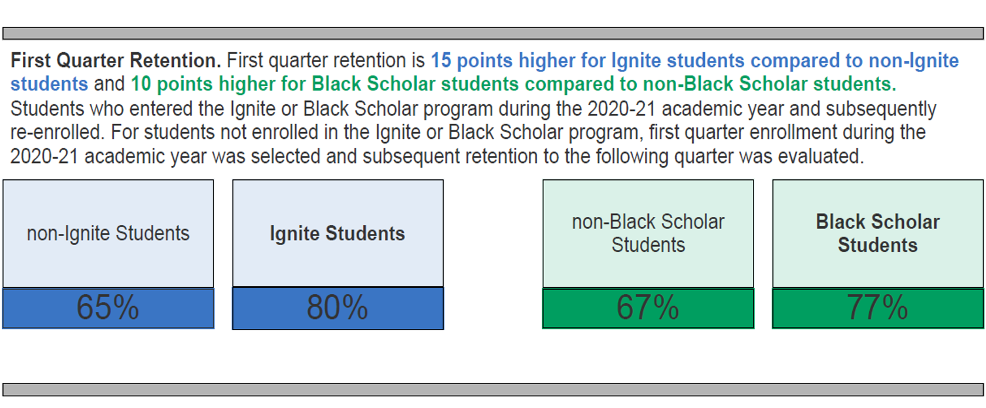
Program Outcomes

Slide 51
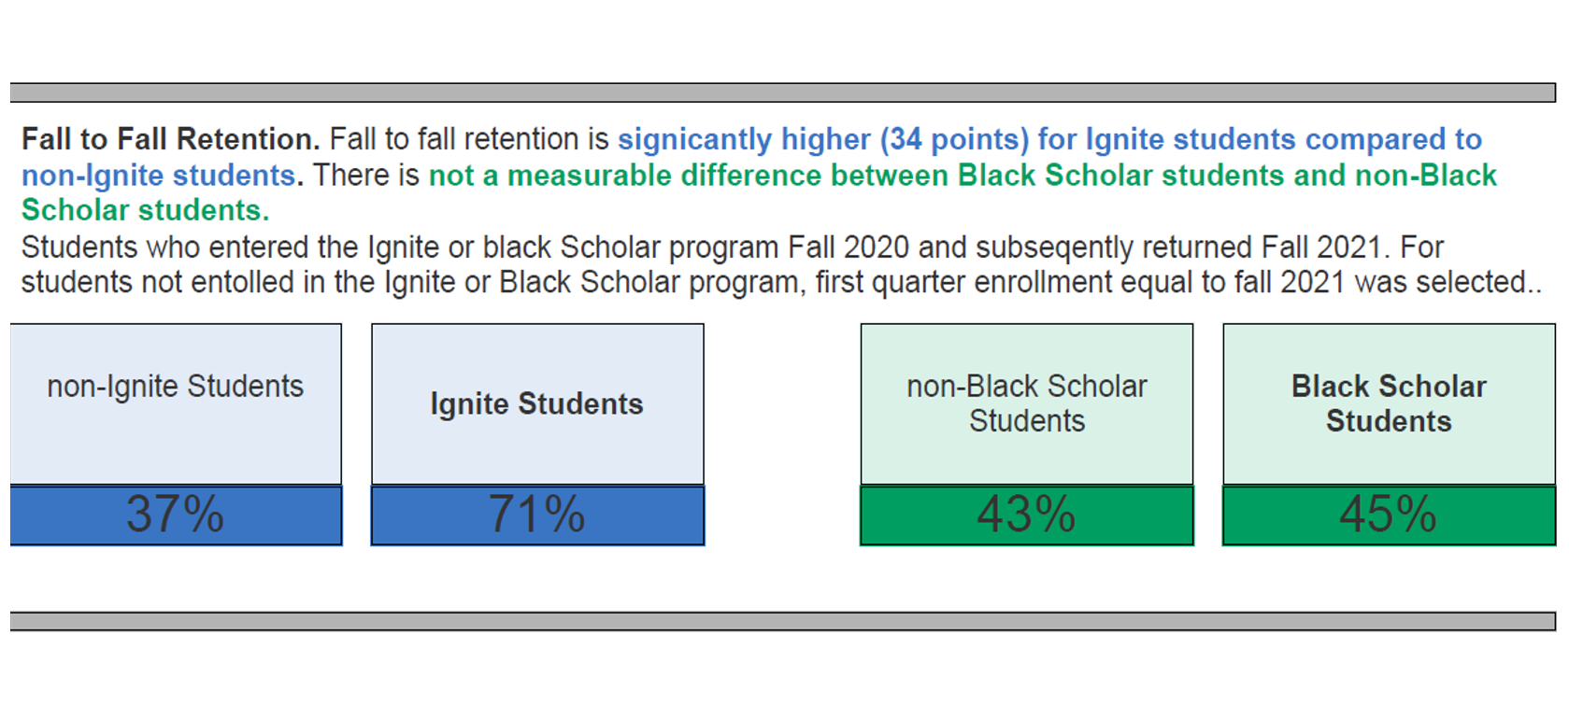
Program Outcomes

Slide 52
Program Outcomes

Slide 53
Culturally Appropriate Student Outreach
Full time Outreach Specialist
Located in Student Services with dotted line to the Office of Diversity and Equity
Days spent in strategically selected high schools
Liaison with Strategic Community Partners

Slide 54
College Highlight: Yakima Valley College
DEI Strategic Plan
Jeannette Quintero
Dra. Ilda Guzman
Steven Sloniker

Slide 55
Background
Support of Executive Leadership
Strategic Plan Workgroups
Present Engrossed Bills 5194 and 5227 to Campus

Slide 56
Start-Up
Co-Lead’s in EDI
Alignment of Engrossed Bills 5194 and 5227 and Strategic Plan
EDI Strategic Plan Draft

Slide 57
Currently
Conduct Campus Climate Assessment
Review the Data and Implement Recommendations
Establish Campus Wide EDI Workgroups
Develop and Align the EDI and Strategic Plan

Slide 58
Next Steps
Workgroups hold campus Wide Report Out Info Sessions
Collect Feedback

Slide 59
CONTACT INFORMATION: COLLEGES
Chari Davenport Samantha Brown Cascadia College cdavenport@cascadia.edu sbrown@cascadia.edu | Parfait Bassalé South Puget Sound Community College pbassale@spscc.edu
Dr. Rashida Willard Clark College rwillard@clark.edu | Jeannette Quintero Yakima Valley College jquintero@yvcc.edu

Slide 60
CONTACT INFORMATION: SBCTC
Ha Nguyen Melissa Williams Julie Huss
Director for EDI Policy Associate for EDI Human Resources Director
360-704-1001 360-704-3992 360-704-4350
hnguyen@sbctc.edu mwilliams@sbctc.edu jhuss@sbctc.edu
Summer Kenesson Christina Pleasants
Interim Director, Research Administrative Assistant for EDI
360-704-4384 360-704-4360
skenesson@sbctc.edu cpleasants@sbctc.edu

Slide 61
Thank you!
For general inquiries, please reach out to EDI@SBCTC.EDU

Slide 62
Question & Answer Session
Optional time for guests to ask questions about:
5194 & 5227
College programs
Please also feel free to refer to the ‘Questions’ Google Doc.

