Slide 1
As you’re logging in, please share one thing in the chat that you’re hoping to learn about the WA Course Design Checklist today.

Slide 2
Meet the WA Checklist (V4)!
Alissa Sells | July 27, 2022
Notes:
Turn on captions and start recording!
Welcome everyone and thank you for joining me on this bright and sunny day for Meet the WA Course Design Checklist (V4)!
My name is Alissa Sells and I am a Program Administrator in the office of Educational Technology & Open Education at the WA State Board.
My main roles are instructional technology and instructional design support for systemwide projects, faculty professional development for teaching online and teaching with technology.
My current work centers around developing the WA Course Design Checklist resources, teaching Canvas 101, and supporting badging.
You can find my contact info on the last slide.
About SBCTC Educational Technology & Open Education: https://www.sbctc.edu/colleges-staff/programs-services/educational-technology-open-education/
Ben Brown from Walla Walla Community College is joining us today to help monitor the chat. Thank you, Ben!

Slide 3
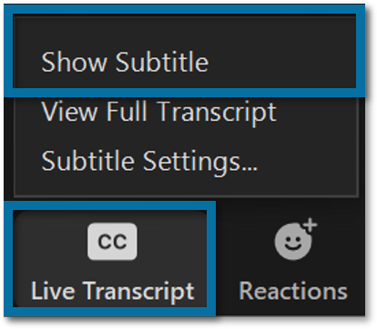
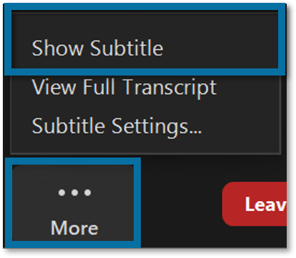
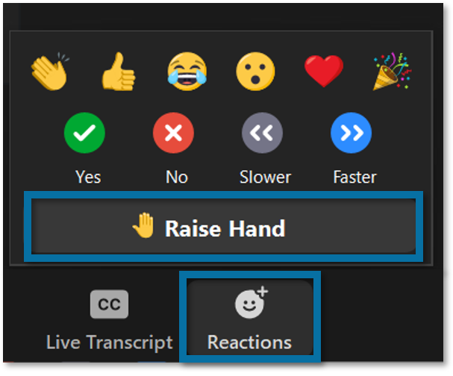
Tools for Today
Live Auto-Transcription: Turn on subtitles if you’d like to view the webinar transcript.
Chat: Ask questions as we go by typing into the Chat.
Reactions Buttons: Use the Reactions buttons to let us know what you’re thinking or raise your hand to ask a question.
Cameras: Turn your camera on during discussions.
Mics: Keep your mic muted when not speaking.

Slide 4
Resource Links
WA Checklist Doc
https://bit.ly/WAChecklist-V4
WA Checklist Resources Shell
https://sbctc.instructure.com/courses/1990829
Notes:
This webinar is being recorded and the link will be shared in the WA Course Design Checklist Canvas shell.
Paste links into the chat:
https://bit.ly/WAChecklist-V4
https://sbctc.instructure.com/courses/1990829

Slide 5
Plan for Our Time
Introduce the newest version of the WA Course Design Checklist and chat about what’s new and different in Version 4.
Share next steps.
Take a quick tour of the WA Checklist (V4) doc.
Answer any WA Checklist questions you may have.
Notes:
I’m hoping to keep this casual and informative with a lot of time for conversation and answering questions. Sound good?
I’m really excited to share the newest version of the WA Course Design Checklist with you today, so let’s get started!

Slide 6
WA Checklist Development Timeline
QM Coordinators Retreat
2018
Rubric Review
2018
Version 1
2018
Student & Faculty Focus Groups
2018-2019
Version 2
2019
ID Focus Groups
2019
Version 3
2019
Equity Team Review
2022
WA Checklist Resources Shell
2019
WA Checklist Guides
2021
2022
Version 4
2017
WACC Presentation
Notes:
This timeline illustrates WA Checklist development. It’s been about three years since Version 3 was released. During the pandemic, I mostly worked on writing the WA Checklist Guides pages.
Throughout its development, I’ve strived for a transparent and collaborative design process, seeking feedback from the larger CTC system and those with more expertise than myself as I went. Between each WA Checklist release, I collected feedback and sought out the expertise of others - both individually and in groups.
Creating equity for students has been an important part of the development process since the beginning.
To complete the feedback process, the WA checklist recently went through an equity review.
Version 4 reflects the feedback from the equity review team. A big thank you to Dr. Claudine Richardson, Ambar Martinez, Guava Jordan, Emeka Udenze, and Amanda Chin for their time and expertise! This version would not have been possible without their input.

Slide 7
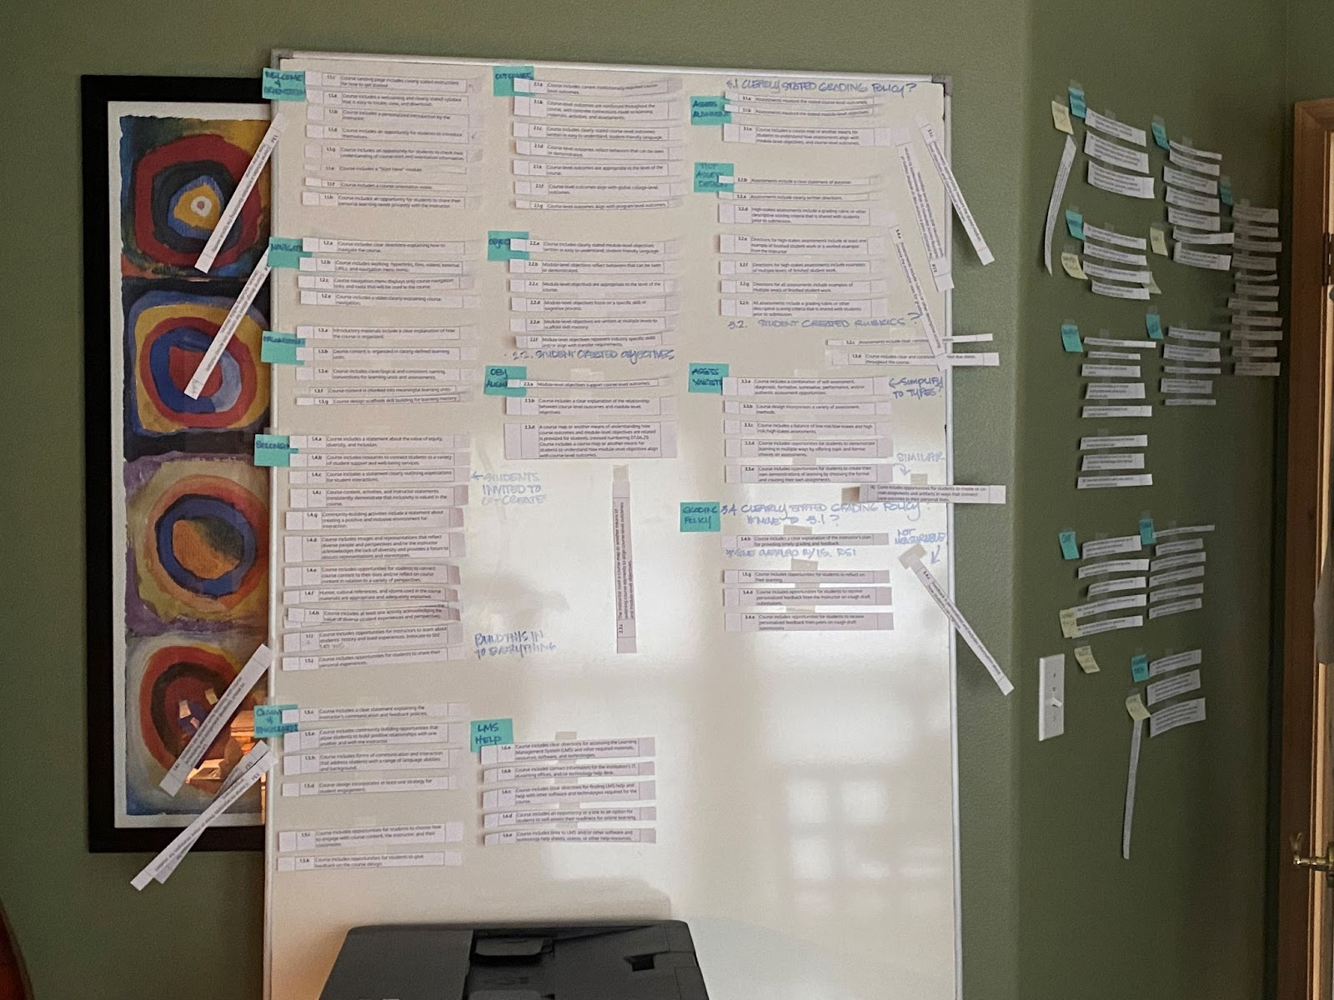
Structural Changes
The Reorganization
Notes:
I completely deconstructed Version 3 and regrouped like items and similar content together for Version 4.
This puzzle-like process allowed me to easily identify gaps and repetitions within the content.

Slide 8
Increased Focus on Equity-minded Practices
V3
V4
Sense of belonging.
Power sharing.
Welcoming language.
Transparency.
Student choice.
Representative images and content.
Reflective course design practices.
V3 concepts plus:
Culture of collaboration, co-creation, and partnership.
Relationship building.
Identifying bias.
Notes:
Why this change:
Equity and inclusion are infused throughout the WA Checklist along with established practices for increasing academic confidence and sense of belonging for students.
Each Standard was written with the goal of demystifying the unwritten rules of success for students in order to make the invisible visible and to help make learning and teaching more transparent.
Feedback from the equity review team and mapping to the Peralta Online Equity Rubric identified several areas that could be strengthened and some important practices that were missing.

Slide 9
New Sections
V3
V4
Course Design & Student Engagement
Sense of Belonging & Student Engagement
Outcomes & Objectives
Assessment & Feedback
Materials & Tools
Outcomes & Objectives
Assessment & Feedback
Materials & Tools
Course Orientation & Structure
Notes:
Why this change:
Every course design decision should be made with equity in mind.
Focusing the new Section 1 on Sense of Belonging and Student Engagement puts equity-minded practices at the beginning of the design process where they belong and helps get course designers thinking about student-centered practices.
Moving the Course Orientation and Structure topics to a new 5th section at the end makes more sense in terms of workflow for course designers.

Slide 10
New Indicators – Power & Partnership
V3
V4
Invites students to:
Co-create the learning environment.
Engage in a learning partnership.
Give feedback on various course elements.
Did not address sharing power with students or inviting students into a learning partnership.
Notes:
Why this change:
V3 power dynamics were weighted toward the instructor.
V4 disrupts the traditional power dynamic by incorporating co-creation, partnership, and feedback.
Co-create = 8
Example: 1.1.d - Course includes a statement clearly describing the instructor's expectations for community interactions and an invitation for students to contribute to or co-create community guidelines.
Partnership = 2
Example: 1.1.c - Course materials use welcoming, easy to understand, and student-friendly language that invites students into a caring and collaborative learning partnership with the instructor.
Feedback = 10
Example: 1.3.j - Course includes an invitation for students to offer feedback on the overall design of the course. (10)

Slide 11
New Standard - Identifying Bias
V3
V4
Now explicitly stated in new Standard 1.2 - Course materials are relevant to students, identify areas of human bias, and acknowledge lack of representation and/or stereotypes within the discipline.
Did not address human bias.
Notes:
Why this change:
Feedback from the equity review team and mapping to the Peralta Equity rubric revealed that identifying bias had not been addressed in Version 3.
A new Standard now specifically addresses relevancy, human bias, and lack of representation.
1.2 Course materials are relevant to students, identify areas of human bias, and acknowledge lack of representation and/or stereotypes within the discipline.
A portion of the new 1.2 Standard was relocated from V3 – Section 4 where it was a single Indicator within a Standard.
Moving the concept to its own Standard increases its visibility.

Slide 12
New Standard - Welcoming Language
V3
V4
Now explicitly stated in Indicator 1.1.b - Course materials use welcoming, easy to understand, and student-friendly language that invites students into a caring and collaborative learning partnership with the instructor.
Topic of welcoming language was not explicitly included.
Notes:
Why this change:
Language matters and how things are phrased can motivate or demotivate students and make the instructor seems approachable or unapproachable.
Friendly, approachable language invites students to engage in learning.

Slide 13
Opportunities to Reimage System Structures
V3
V4
5.1.a - Course includes a welcoming and clearly stated syllabus that is easy to locate, view, and download.
1.1.a - A course syllabus containing clearly stated course policies and required institutional policies is easy to locate and download.
Notes:
Why this change:
The V3 Indicator and Guides explanation focused on the syllabus as a contract containing policies.
1.1.a - A course syllabus containing clearly stated course policies and required institutional policies is easy to locate and download.
1.1.a Original Guides Text
Revised Indicator and Guides explanation focus on the syllabus as a student’s guide to learning success.
5.1.a - Course includes a welcoming and clearly stated syllabus that is easy to locate, view, and download.
1.1.a Revised Guides Text
This change encourages course designers to re-envision current structures and practices and make small changes within their sphere of influence that can lead to systemic change.
Example: A welcoming syllabus guides students to success, invites partnership in learning, and begins the relationship building process from day one.
EXAMPLE: Shifting course designers away from the traditional view of a syllabus as a “contract” to the view of a syllabus as a “guide to success” for students.

Slide 14
Labeling Change
V3
V4
Essential
Best Practice
Exemplary
Essentials
Next Steps
Notes:
Why this change:
Essentials, Best Practice, and Exemplary implied an unintended hierarchical relationship between the Indicators.
New labels of Essentials and Next Steps remove the unintentionally implied levels of good, better, best while still providing room for growth in practice.

Slide 15
Improved Readability & Usability
V3
V4
Rewritten in active voice with simplified and consistent sentence structure.
Was mostly written in passive voice.
Improved consistency of language within sections and across the document.
Rephrased or removed unmeasurable Indicators.
Had some inconsistencies in language and phrasing.
Had a few unmeasurable Indicators.
Notes:
Why these change:
Simplifying and using consistent language across the document improves readability and clarity.
Example: All of the feedback Indicators are written with the same phrasing.
Example: Language in Section 4 – Materials and Tools consistently refers to course materials and course technologies rather than using a variety of words like content, resources, and tools.

Slide 16
Improved Alignment
V3
V4
Relocated, combined, and/or removed repetitive content.
Contained some repetitive or duplicated concepts.
Notes:
Why this change:
Eliminating and combining repetitive concepts simplifies the content and improves the alignment of concepts and topics across the document.

Slide 17
New Standards - Accessibility
V3
V4
4.6 - Course includes information about course accessibility and available access support resources.
4.7 - Course materials follow guidelines for text accessibility.
4.8 - Course materials follow guidelines for multimedia accessibility.
4.4 - Course content is designed using best practices for accessible course design.
Notes:
Why this change:
The V3 accessibility Standard had 23 Indicators which made it overwhelming in length.
4.4 Course content is designed using best practices for accessible course design.
The same Indicators are now chunked into 3 separate Standards grouped by topic.
4.6 Course includes information about course accessibility and available access support resources.
4.7 Course materials follow guidelines for text accessibility.
4.8 Course materials follow guidelines for multimedia accessibility.
This change makes the concepts easier to understand and apply.

Slide 18
Next Steps in WA Checklist Development
Map the WA Checklist (V4) intersections to the Peralta Equity Rubric, TILT, Quality Matters Rubric, UDL, and Guided Pathways, etc.
Revise the WA Checklist Guides architecture to mirror V4 content and begin filling in content gaps created by reorganizing and adding new Sections, Standards, and Indicators.
Retire the WA Checklist (V3) at the end of the summer.
Notes:
Note: During reconstruction, the Guides are going to be a little messy and confusing.

Slide 19
Now, let’s take a tour and answer some questions!

Slide 20
Contact me!
Alissa Sells
Program Administrator
Educational Technology & Open Education
WA State Board for Community & Technical Colleges
asells@sbctc.edu
425.239.0456

Slide 21
Thank you!
Unless otherwise specified, the content in this presentation is licensed under a Creative Commons CC BY 4.0 license.
Notes:
This presentation is openly licensed so please feel free to use it, adapt it, and share it!

Slide 22
The following slides are included for quick reference in case of technical difficulties and show screenshots of the WA Checklist V4 structure.

Slide 23
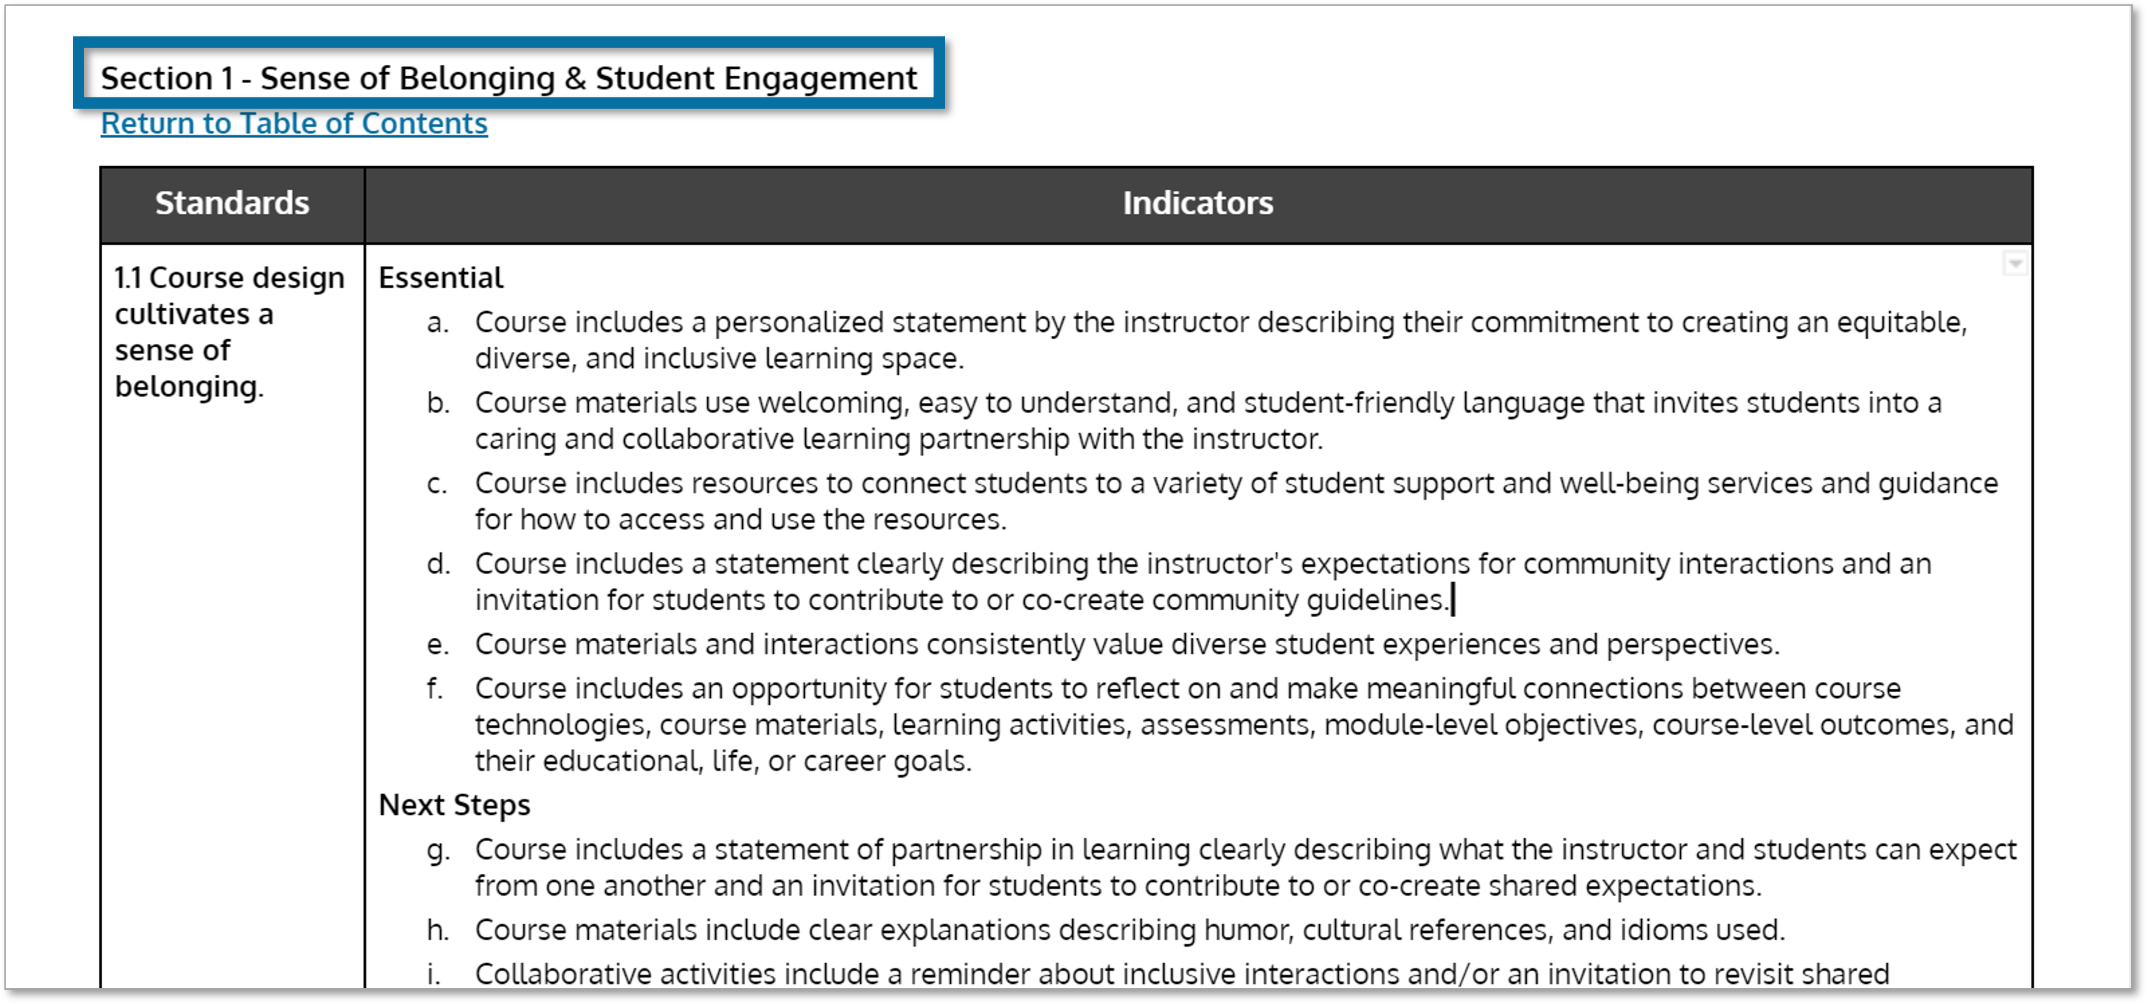
Sections
Section 1 –
Sense of Belonging & Student Engagement
Section 2 –
Outcomes & Objectives
Section 3 –
Assessment & Feedback
Section 4 –
Materials & Tools
Section 5 –
Course Orientation & Structure
Notes:
The WA Checklist V4 has five Sections focused on specific topic areas.
These topics can help course designers target the general areas of their course they’d like to work on.

Slide 24
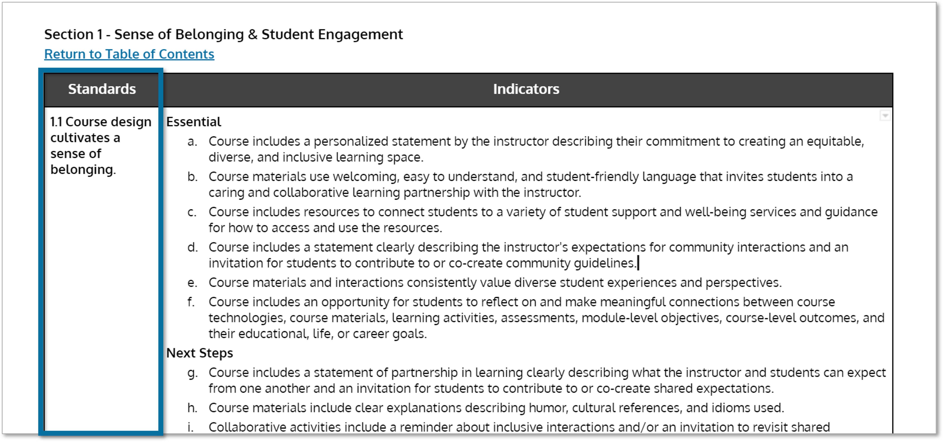
Standards
Each section contains a set of numerically labeled Standards.
Section 1 contains three Standards: 1.1, 1.2, and 1.3.
Notes:
The Standards and Indicators included in the WA Checklist are based on researched best practices for online course design.
Equity and inclusion are infused throughout the WA Checklist along with established practices for increasing academic confidence and sense of belonging for students, especially for BIPOC students.
Each Standard was written with the goal of demystifying the unwritten rules of success for students in order to make the invisible visible and to help make learning and teaching more transparent.
The Standards in each section can help you narrow down the target area you’ve chosen to concentrate on.
The WA Checklist is not perfect and using won’t fix everything, but it does give you a place to start.

Slide 25
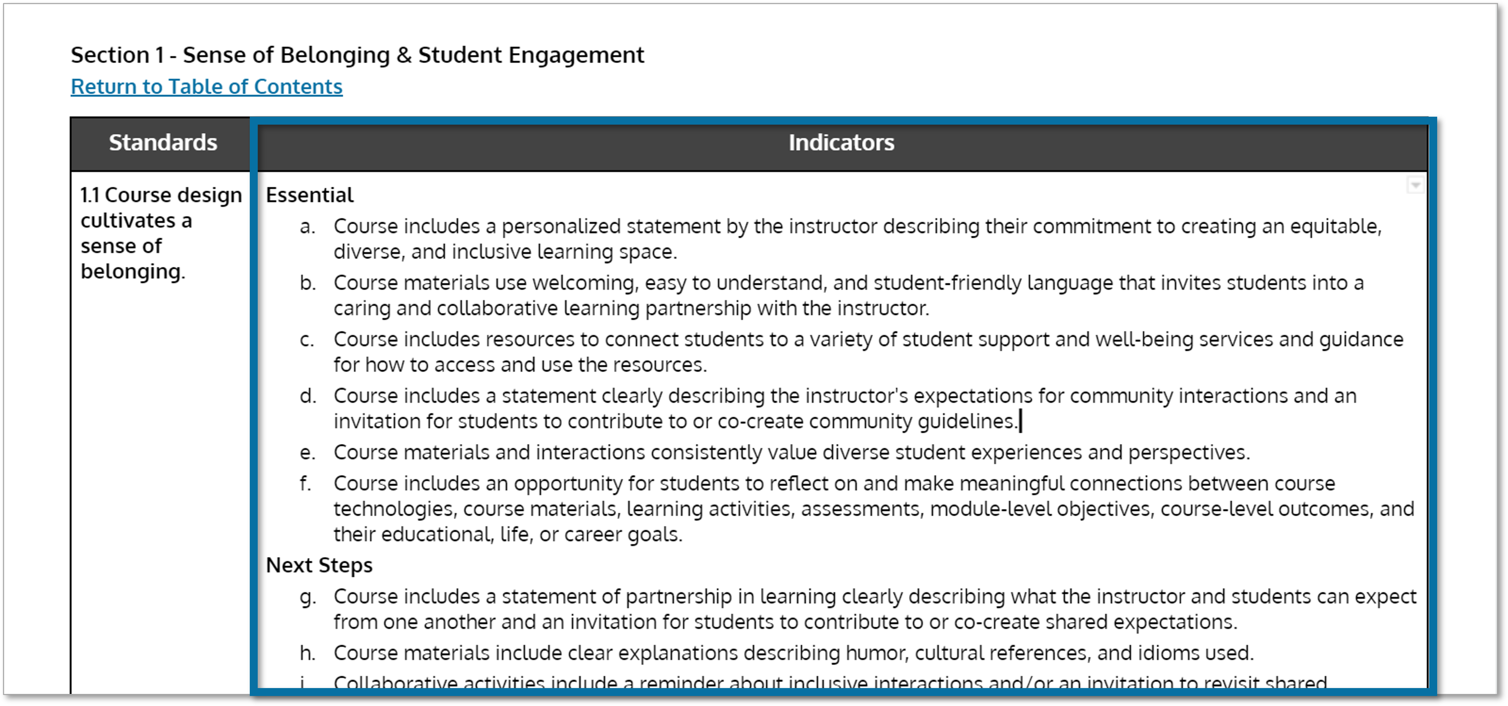
Indicators
Each Standard is divided into a set of alphanumerically labeled Indicators.
Standard 1.1 contains ten Indicators:
1.1.a - 1.1.j
Notes:
The Indicators for each Standard can help course designers narrow their focus even more and can also help prioritize those areas by level of importance.

Slide 26
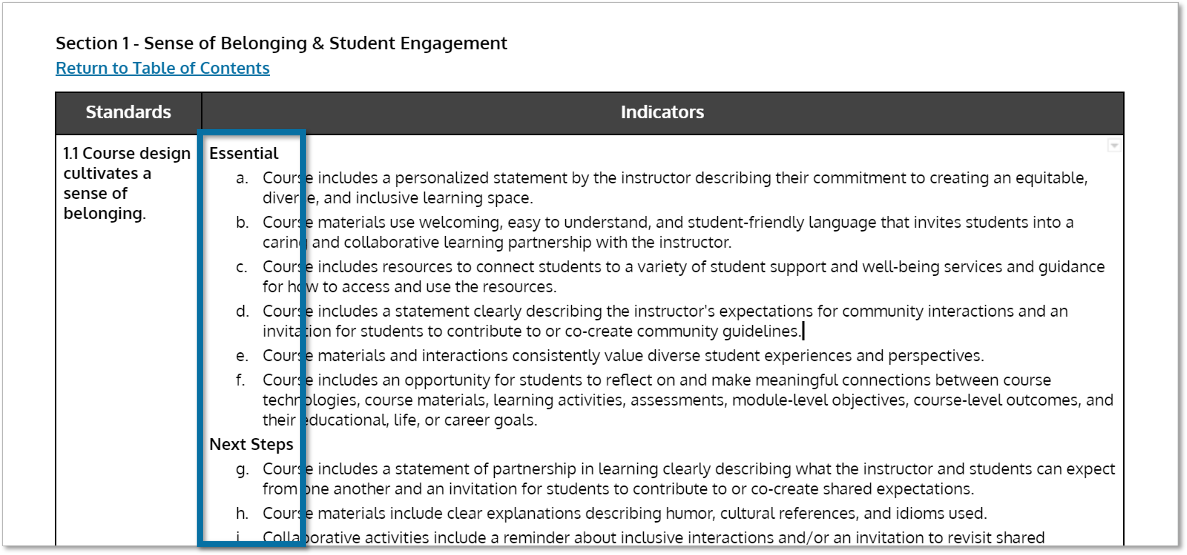
Categories
Each Indicator is further categorized as being one of two types of course design practices:
  Essentials
  Next Steps
Notes:
The Essential and Next Steps structure identifies the foundational elements students need most for success in an online course.
This structure also allows room for growth in course design practices and accommodates the mixing of various course elements shown to set the stage for student success.
No course will ever be perfect, and no course will ever include all of these items, but a well-designed course will contain the Essentials.

Slide 27
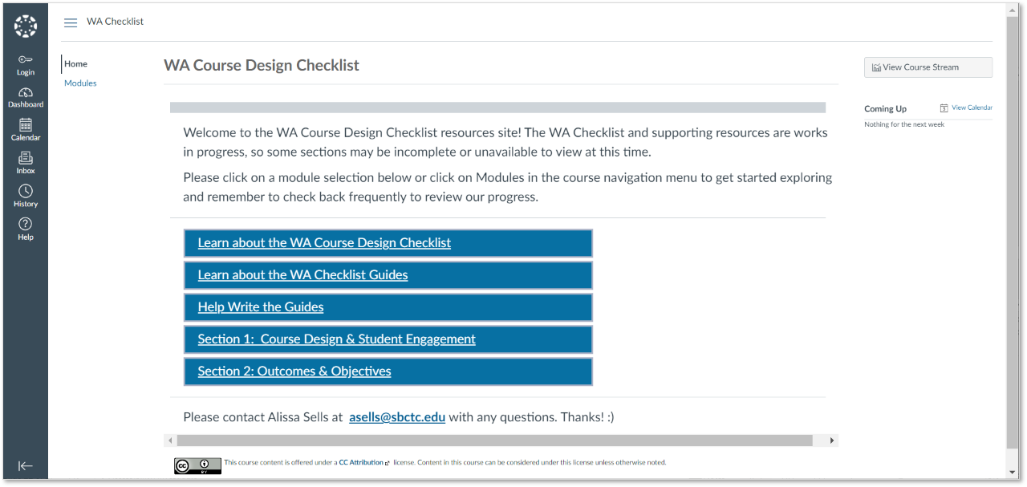
WA Checklist Resources Shell
Notes:
Where can you find the WA Checklist (V4) … in the WA Course Design Checklist resources shell in Canvas.
This is a public course so you can access it at any time without registering.
Paste course link into Chat: https://sbctc.instructure.com/courses/1990829

Slide 28
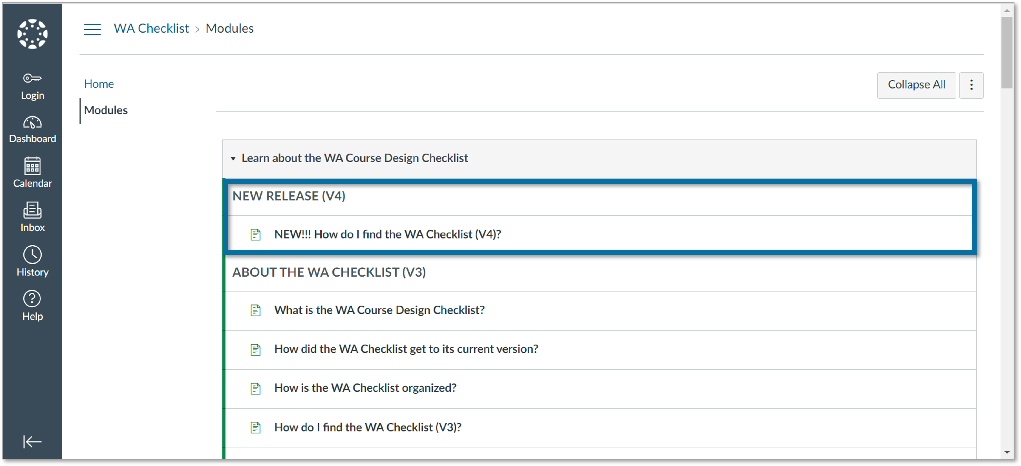
How do I find the WA Checklist V4?
Notes:
Look for it at the top of the "Learn about the WA Course Design Checklist" module in the WA Checklist Resources shell in Canvas

Slide 29
The following slides are included for quick reference and show screenshots of the WA Checklist V3 Guides pages.
The WA Checklist V4 Guides will keep the same main organizational structure.

Slide 30
The WA Checklist resources shell contains …
Background about the WA Checklist project.
The WA Checklist document.
An explanation of how the WA Checklist is organized and licensed.
The WA Checklist Guides.
An explanation of how the WA Checklist Guides are organized and licensed.
Options for contributing and leaving feedback.

Slide 31
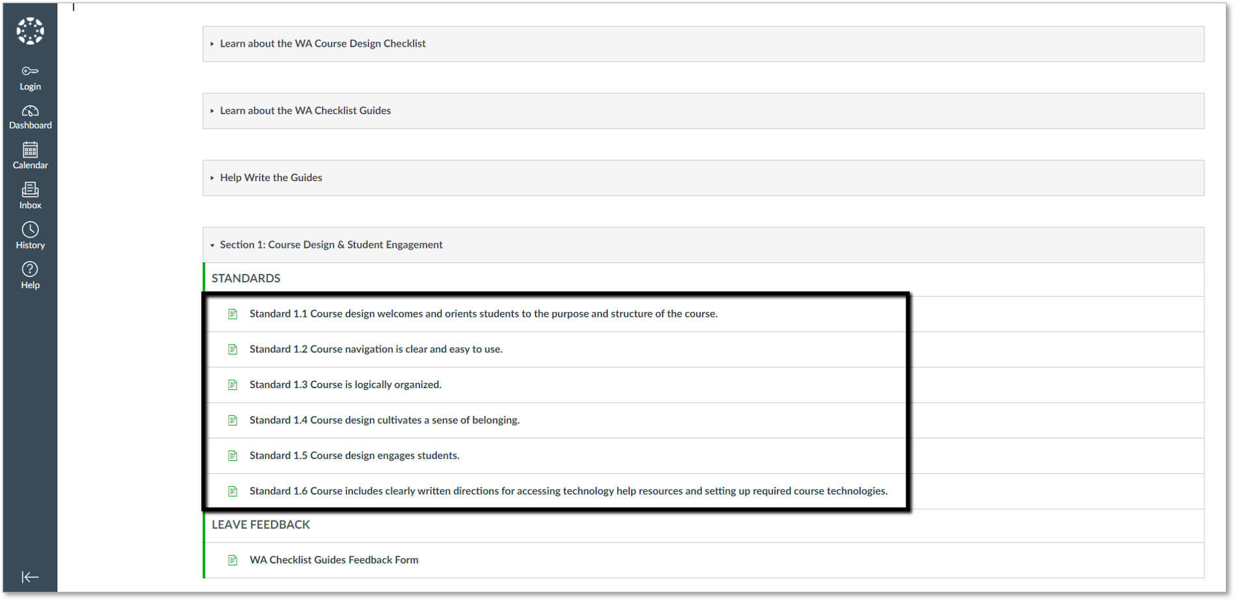
WA Checklist Guides Modules
Notes:
The WA Checklist Guides are one of many supporting resources for the WA Course Design Checklist that are currently under construction.
The Guides are also a work in progress, so you may find some areas that are incomplete.
Once complete, the Guides will provide context and explanation of the individual Standards and Indicators.
Currently, the Guides modules for Sections 1, 2, and 3 are open. Please note that the Guides module for Section 3 contains only 2 of 4 Standards.
If you’d like to contribute to this work, please visit the module titled: Help Write the Checklist Guides.

Slide 32
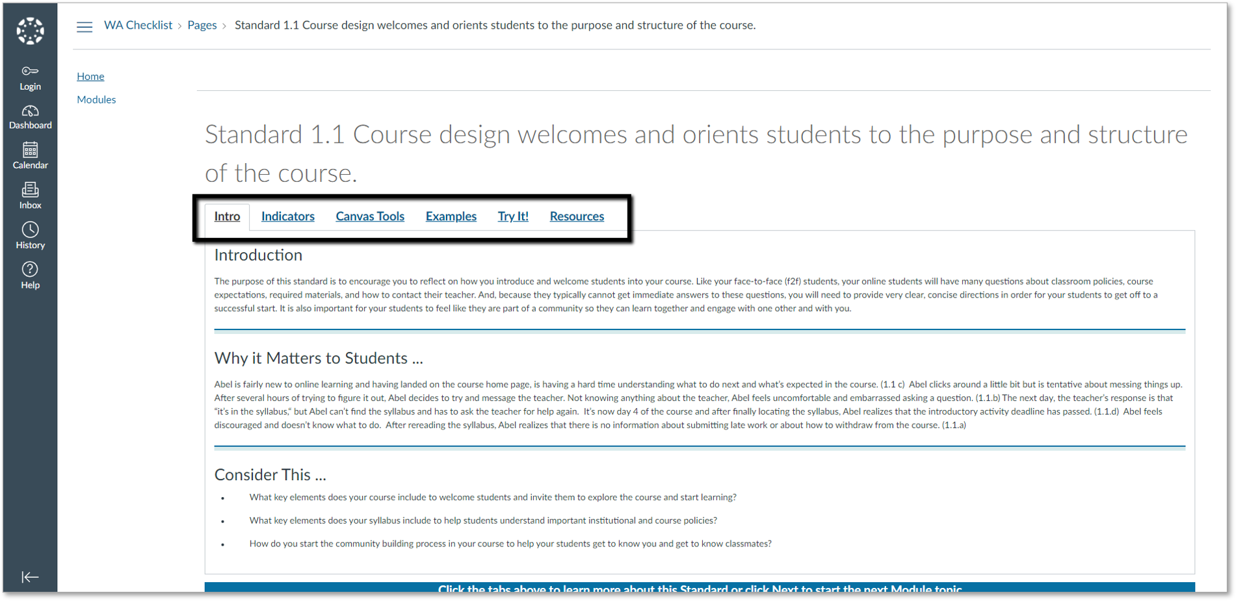
WA Checklist Guides Tabs
Notes:
The tabbed layout of the WA Checklist Guides keeps all of the related content bundled together for each Standard in an easy-to-read format.
The Intro tab introduces the Standard, gives a short scenario of why addressing the Standard in your course matters to students, and then gives a short list of reflection questions to ponder as you work through your course.

Slide 33
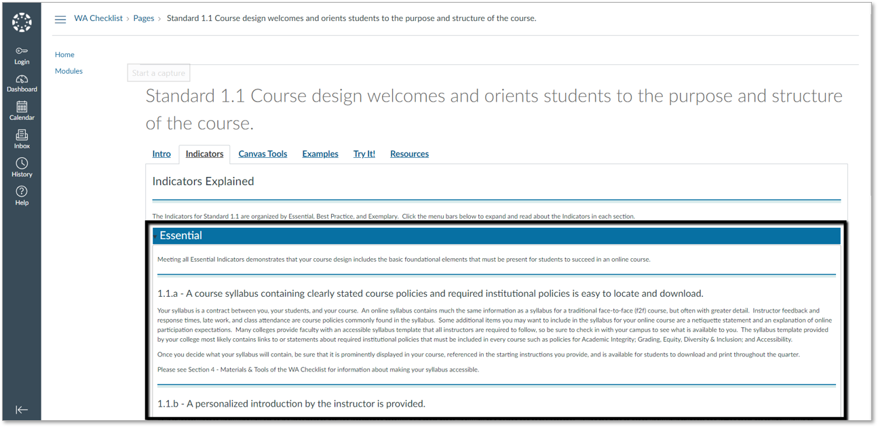
Indicators Tab
Notes:
On the Indicators tab you will find a brief explanation of the topic addressed by each Indicator.
The Indicators are sorted by Essential, Best Practice and Exemplary.

Slide 34
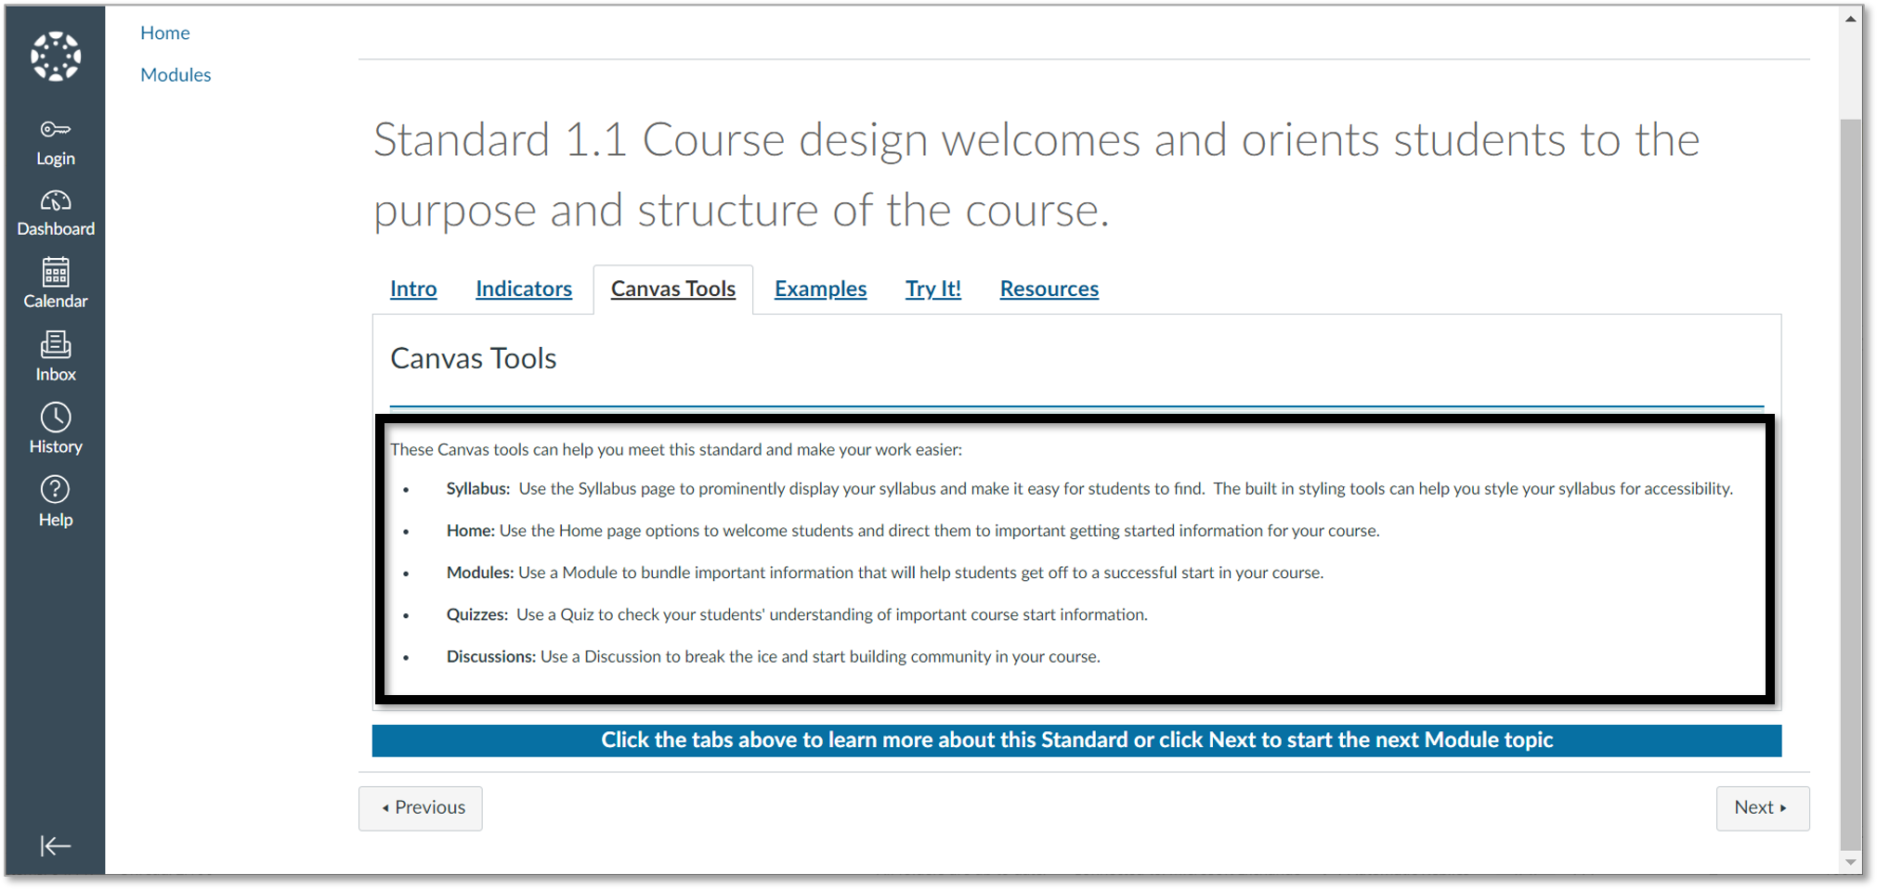
Canvas Tools
Tab
Notes:
On the Canvas Tools tab you will find suggestions for Canvas tools that can help you apply each Standard to your course.

Slide 35
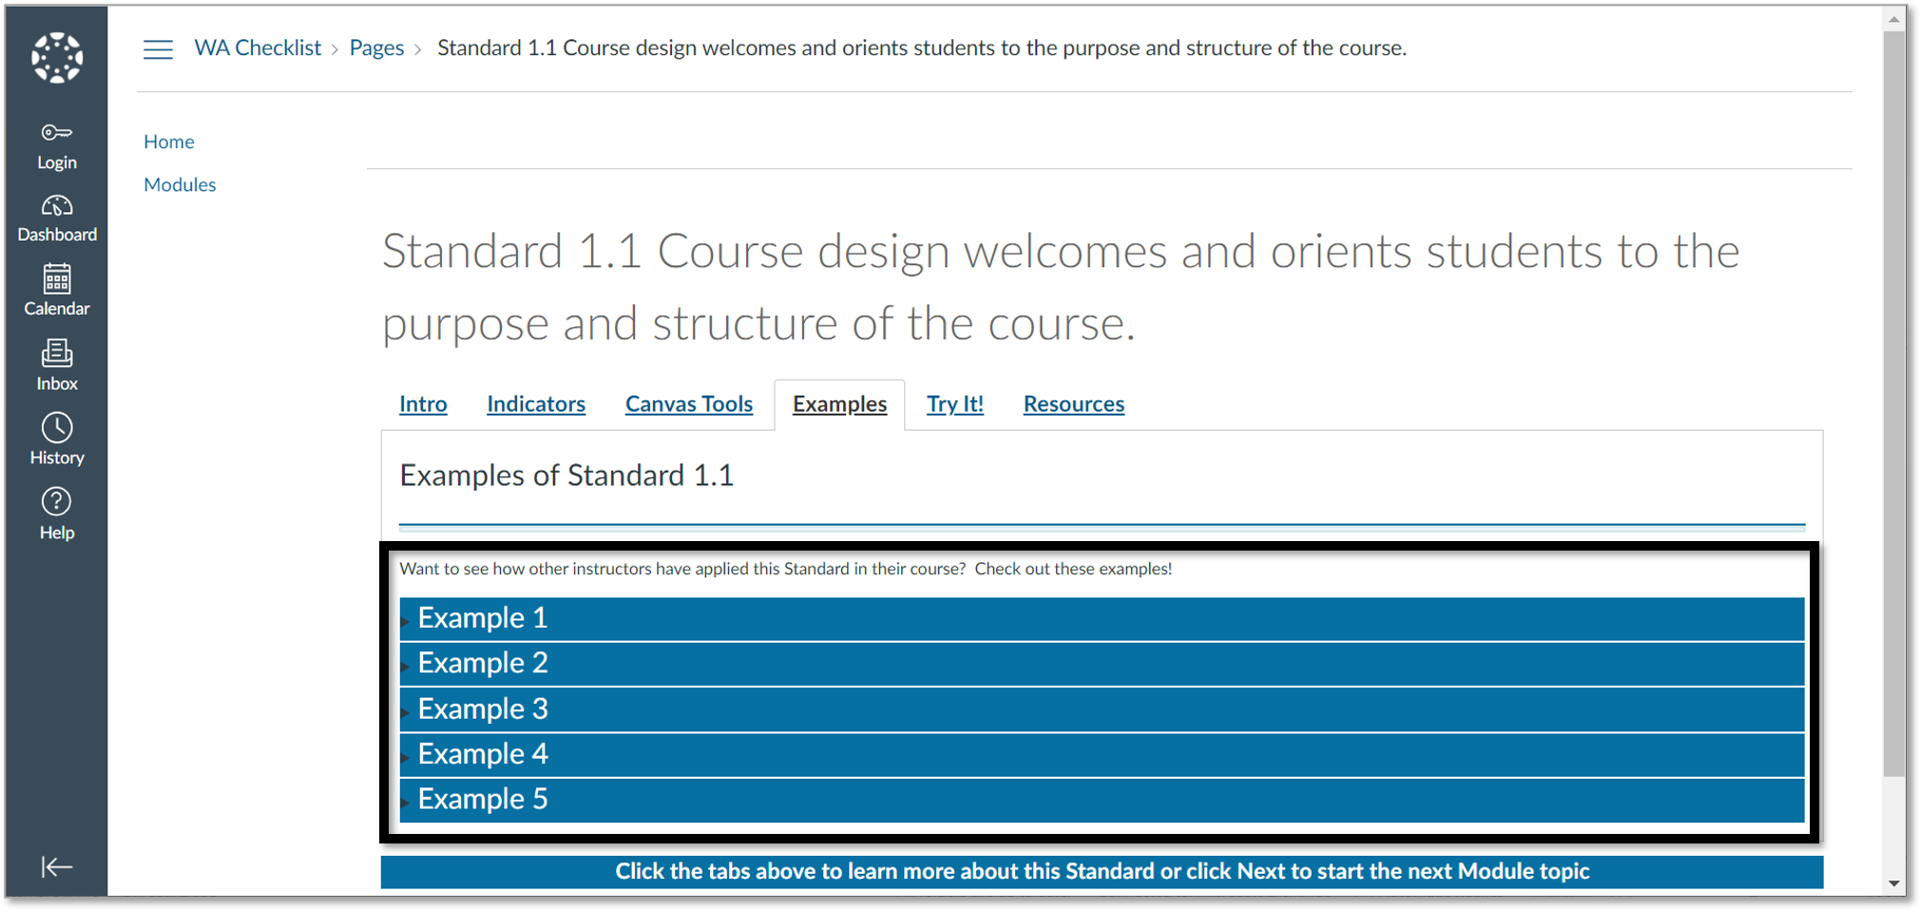
Examples Tab
Notes:
Eventually, the Examples tab will house examples of how faculty across the state are applying the WA Checklist Standards and Indicators to their courses.
If you’d like to share an example from your course, please email me! asells@sbctc.edu

Slide 36
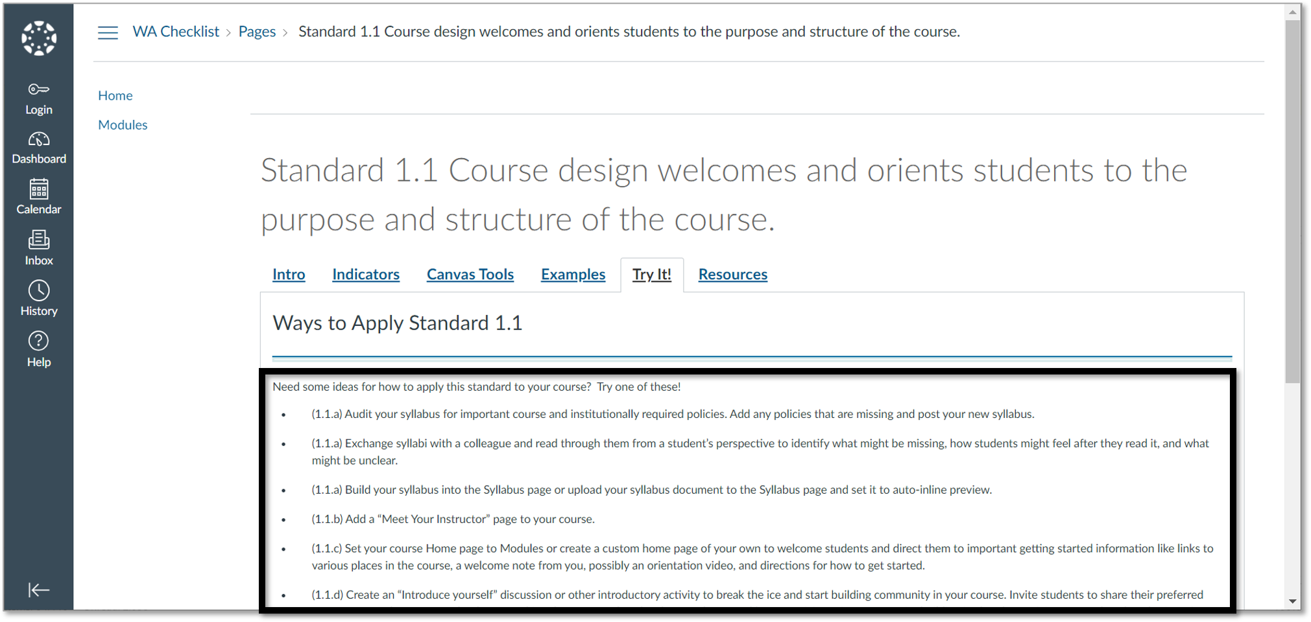
Try It! Tab
Notes:
The Try It! tab contains a list by Indicator for each Standard that contains small, easy to incorporate practices you can try anytime.
The list can help you generate helpful ideas for small additions you can make to work toward making improvements in your course. BIG IMPACT
If you can’t do it all at once, break the ideas down into their component parts and work on them as you can but be sure to set a timeline for completion.

Slide 37
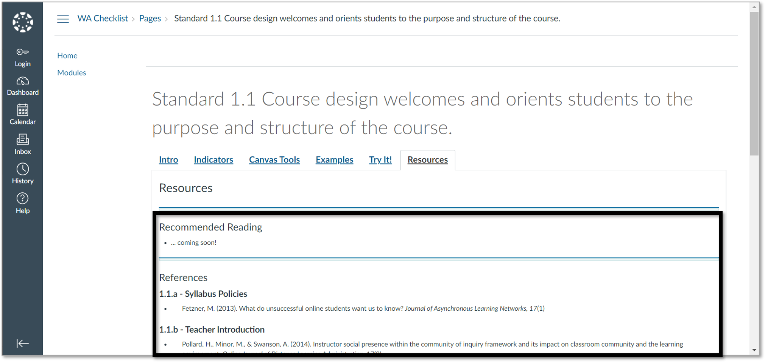
Resources Tab
Notes:
The References tab includes a list of recommended reading and a list of references for each Indicator in the Standard.

Slide 38
References
SBCTC and Sells, A. (2021) WA Course Design Checklist Resources. [Public Course in Canvas] https://sbctc.instructure.com/courses/1990829

