Slide 1
SESSION I
Welcoming the Mess
The believing and believing game: anti-racist writing assessment
Jeffrey Klausman (jklausman@whatcom.edu)
And the assessment work group: Ian Sherman, Green River, Candice Morrow, Peninsula, Courtney Edwards and Jason Loan, Pierce, Tim Roe, Spokane

Slide 2
Overview of session
Methods
Look at the “believing and doubting” game from Peter Elbow
Consider why we’re talking about assessment now
Look at the data on student success in English 101 to understand the problem
Practice “believing and believing” on pairs of conflicting propositions about student success
Purpose
Our purpose is to develop a better understanding of the belief systems that ground our views on student success: why students succeed and fail and what can be done to make things better. Becoming aware of our beliefs as well as different ones can loosen the tie between beliefs and our sense of identity allowing us to listen to one another better and to entertain ideas that are different from our own.

Slide 3
Personal stake: yours
Speaker
What’s your background, your family’s story, and how do you think that influences your view of the value and purpose of higher education?
Listener
Reflect back what you hear, feel free to ask questions for a fuller picture.
Notes:
Note: listeners, reserve your own sharing until roles are switched.

Slide 4
Welcoming . . . all
Early adopters
Those who adopt innovations eagerly and early, often only on hope and promise of significant improvement
Cautious adopters
Those who explore innovations early but with more skepticism and are slower to adopt
Resistors
Those who are skeptical of and resistant to innovations, adopting only reluctantly and late
Notes:
In instigating any change, the process can be “fast, inclusive, effective”--choose any two. Dean Dad, Confessions of a Community College Dean, Inside Higher Ed

Slide 5
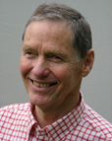
The Believing and doubting Game
The doubting game represents the kind of thinking most widely honored and taught in our culture. It’s sometimes called “critical thinking.” It's the disciplined practice of trying to be as skeptical and analytic as possible with every idea we encounter. By trying hard to doubt ideas, we can discover hidden contradictions, bad reasoning, or other weaknesses--especially in the case of ideas that seem true or attractive. We are using doubting as a tool in order to scrutinize and test.
Notes:
Slide Deck with the “Believing Game” slides Jen put together: http://bit.ly/2NmMgim

Slide 6
The Believing and doubting Game
In contrast, the believing game is the disciplined practice of trying to be as welcoming or accepting as possible to every idea we encounter: not just listening to views different from our own and holding back from arguing with them; not just trying to restate them without bias; but actually trying to believe them.
The believing game asks us to scrutinize unfashionable or even repellent ideas for hidden virtues. Often we cannot see what's good in someone else's idea (or in our own!) till we work at believing it. When an idea goes against current assumptions and beliefs--or if it seems alien, dangerous, or poorly formulated---we often cannot see any merit in it.
Notes:
Slide Deck with the “Believing Game” slides Jen put together: http://bit.ly/2NmMgim

Slide 7
Ground rules
Work with a partner, sit side by side.
Choose a “Propositions” to consider (everyone has two pairs of propositions)
Take turns: Partner A is the speaker/believer; Partner B is the listener/believer.
Partner A: Read the first proposition of the pair and then explain to your partner why it is “true”-- “This is true because . . .”
Partner B: Listen and ask questions: Why do you believe that? What else is true about that?
After 3-5 minutes, when the bell rings, switch roles. Turn to face the opposite direction.
Partner B: Read the second of the pair and try to believe it . . . “This is true because . . . Partner A: listen and help the believer!
When you’re finished, there’ll be a debrief.
Notes:
JEN TAKES OVER: Remind! This will be difficult! Cognitive dissonance!

Slide 8
Believing and believing game?
Proposition A: Cats are the best pets for most families because they require relatively little maintenance, are largely independent, and yet provide companionship and warmth. Moreover, they tend to be good and patient with young children as well as the elderly.
Proposition B: Dogs are the best pets for most families because they provide reliable and energetic companionship, are extremely patient and appreciative, and can be trained to fit into a variety of situations, making them wonderful companions for young children as well as families on the go. Moreover, dogs have been shown to be great companions for the elderly.
Notes:
Rather than believing and then doubting the same proposition, we’re going to try believing one proposition and then believing a contrasting proposition.The virtue of this approach is that it allows us to practice believing viewpoints that are opposing but not mirror opposites, which is common in complex issues.

Slide 9
Groundwork
We all have a personal stake in higher education . . .
We have to welcome all views . . .
We can get somewhere by practicing the believing and believing game . . .

Slide 10
ENGL&101 Recommended outcomes, defining success

Slide 11
Recommended ENGL&101 Outcomes
Faculty assessment of outcomes from 24 colleges around the state (fall 2017)
Work group gathered data and found common themes
Faculty assessed themes and WPA Outcomes statements
Work group developed common outcomes
Faculty offered feedback . . . revisions . . . feedback . . . revisions (through fall 2018)
Six “Recommended ENGL&101 Student Learning Outcomes” adopted (Yakima Valley Spring 2019)

Slide 12
Outcomes beg assessment
Q: Okay, we have outcomes. Now, how do we teach to them? How do we know
students are learning them? How do we measure success?

Slide 13
Student success: a definition
Q: What does it mean when a student is successful?
When a student is successful, they have demonstrated competence of the student learning outcomes but also
demonstrated ability to manage the “hidden curriculum,” such as attendance requirements, meeting due dates, decoding assignments, etc.
Our job, as educators, is to help as many of our students as possible be successful. In other words, we are successful when they are successful.
Notes:
This is making me think of the Gerald Graff articles on assessment-- particularly the one where he talks about serving on committees where they wanted to attract “The best students” (the best student fetish). In that article, he says that he always wanted to say, “why don’t we try attracting the worst students … and see if we can teach them something?”

Slide 14
Course success: a definition
Q: What does it mean when we are successful? a course is successful?
We are successful when our course produces successful students at an acceptable rate.
Our job as educators--and as leaders on our campuses--is to design courses that ensure that as many students as possible are successful. But how many? What’s an acceptable rate? And what are the factors that impact success?
Notes:
As leaders, we have some influence over the shape of the programs we teach in--the coherence among sections of the same course and the coordination of courses that intersect sequentially or horizontally.

Slide 15
ENGL&101 Difference across the state, within the same college
Education may “go so far as to enable a person to be moved emotionally by statistics.”
Bertrand Russell, Education and the Good Life (1926)

Slide 16
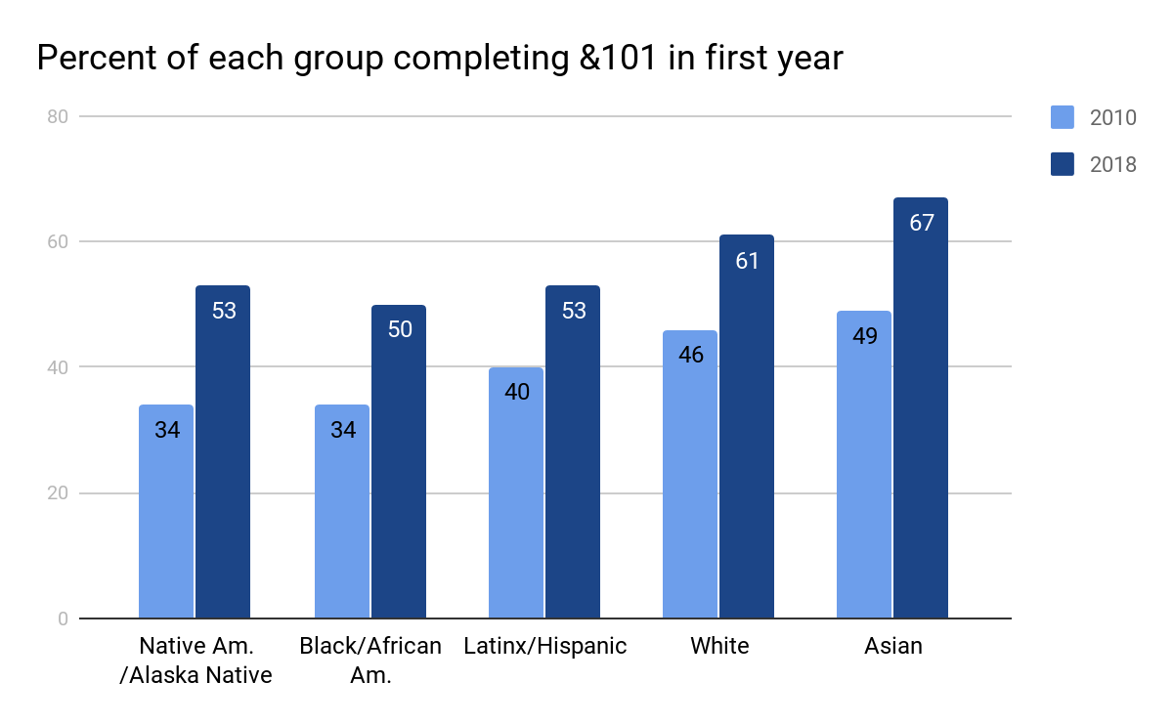
Access to and completion of &101 in first year
Notes:
We can see that the work we’ve done with placement, with program sequencing, with ALP and support courses has really paid off. More students across the board have access to and are completing ENGL&101 in their first year. However, we can see that differences among groups remain. So, more work to do but encouraging.

Slide 17
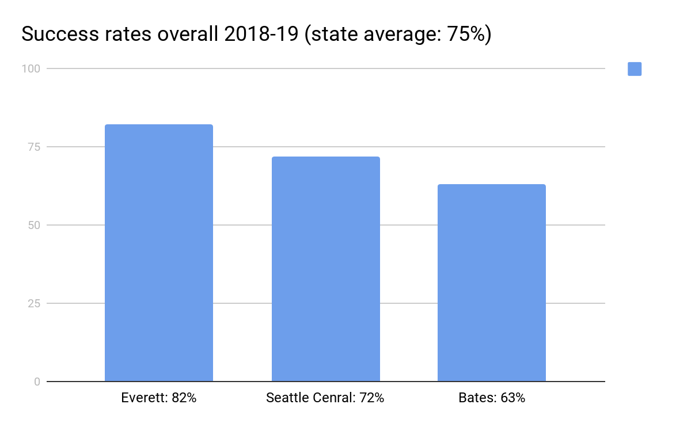
ENGL&101 is different at different colleges
Notes:
I think here might be a place to discuss WHY success rates? I’m thinking of the comments in the survey: http://bit.ly/36zAsQD
Specifically this one: “Also, there's a tendency to create dichotomies--instructors who had lower pass rates were thrown under the bus, while those with high pass rates were praised. We don't know what happens in those classrooms, what modalities are being used, and whether there may be other explanations for the discrepancies aside from the construction of a "weeders vs. feeders" false dichotomy.” We are not “throwing people under the bus”-- we’re presenting evidence to be explored … Basically, what does us looking at the metrics of success rates mean? What does this NOT mean?

Slide 18
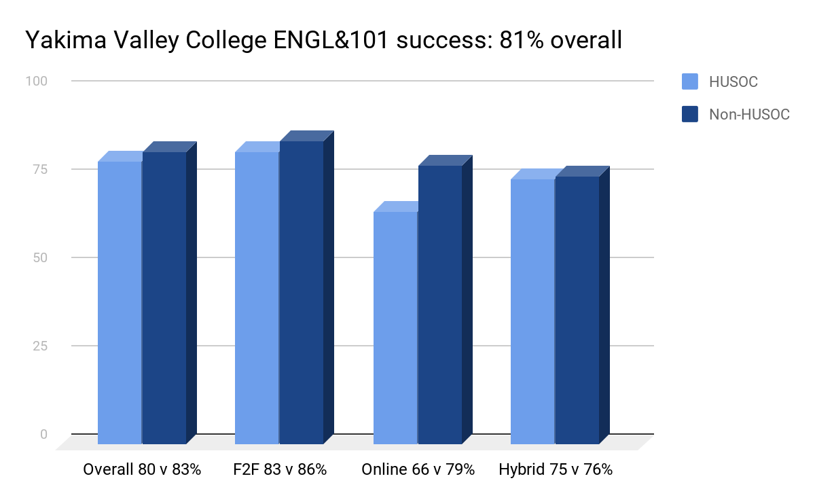
ENGL&101 is different in the same college
Notes:
2018-19

Slide 19
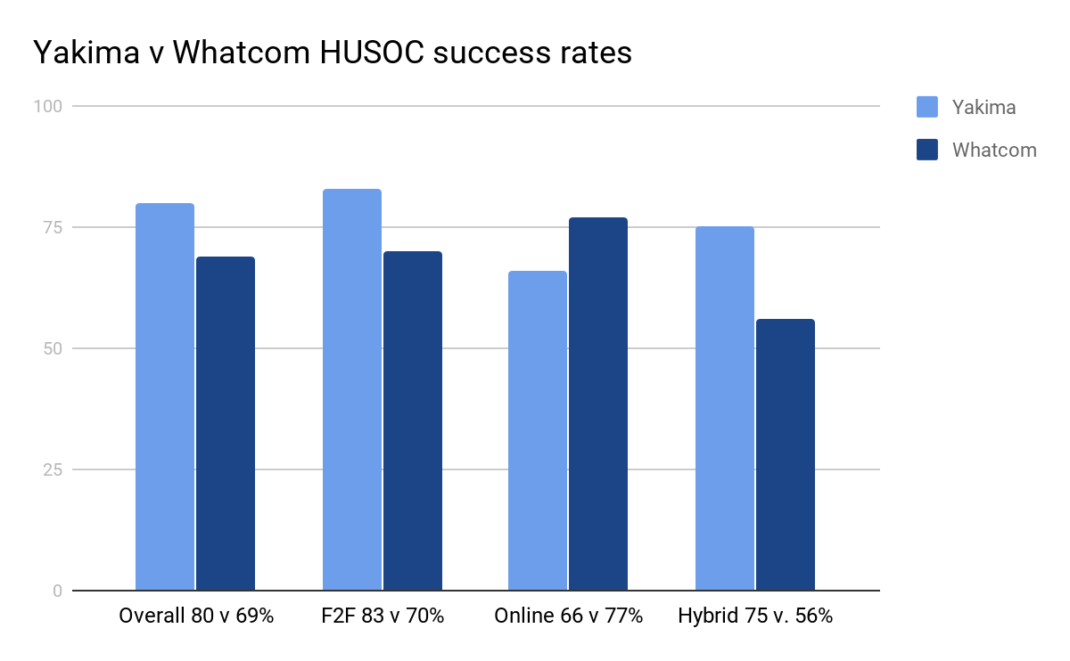
ENGL&101 is different for the same group
Notes:
Here’s a quote I am thinking about …For this person, and the other faculty this voice may represent … can we say again that as we broaden and deepen … you did a full presentation at the winter meeting on inequity of placement measures such as Accuplacer. And just a reminder, to this person and to others, that HU students DO experience opportunity gaps in education. Our choice, as a system, is to say, “do we punish the student for experiencing those equity gaps?” That’s not quite right … it’s something along the lines of, “Do we recreate those opportunity gaps?” Or do we finally try to address them? And ot this person … and to the others who are quietly thinking this … we know that it IS because, in this hypothetical, the student is Hispanic, as HU students experience opportunity gaps at a higher rate than White or Asian students. Anyway, I”m just wondering if we can embed counter-arguments to the voices in the survey at specific points where those resistant voices might show themselves in this slide deck? This might not be the right place … but I do want to try to address some of the feedback in a way that is not shaming but shows people we are paying attention to their voices?
assumption that our placement systems, 101 classes and 101 outcomes are inequitable. I'm not saying they ARE indisputably equitable, but I wasn't given any specific data to prove they're inequitable either. I've been running English placement at my school for 2 years. Yes, more Hispanic students place into developmental education, but I don't assume that means the test or system is inequitable. If that student grew up in a home where English wasn't spoken, went through a poorer school system, and maybe the family struggled with money so school wasn't always his priority...then I fully expect him to place into dev ed. He needs to start a level below college, so what? It's not BECAUSE he's Hispanic; it's because these other factors in his life weren't as supportive of education. He doesn't get to place into 101 BECAUSE these factors excuse his abilities
Awesome! Good luck, Jeff! I’m awed at what you accomplish.
Back at 12, Jen--off to an outcomes meeting: proposing we adopt the statewide recommended 101 outcomes for us starting next fall. Looks good so far.

Slide 20
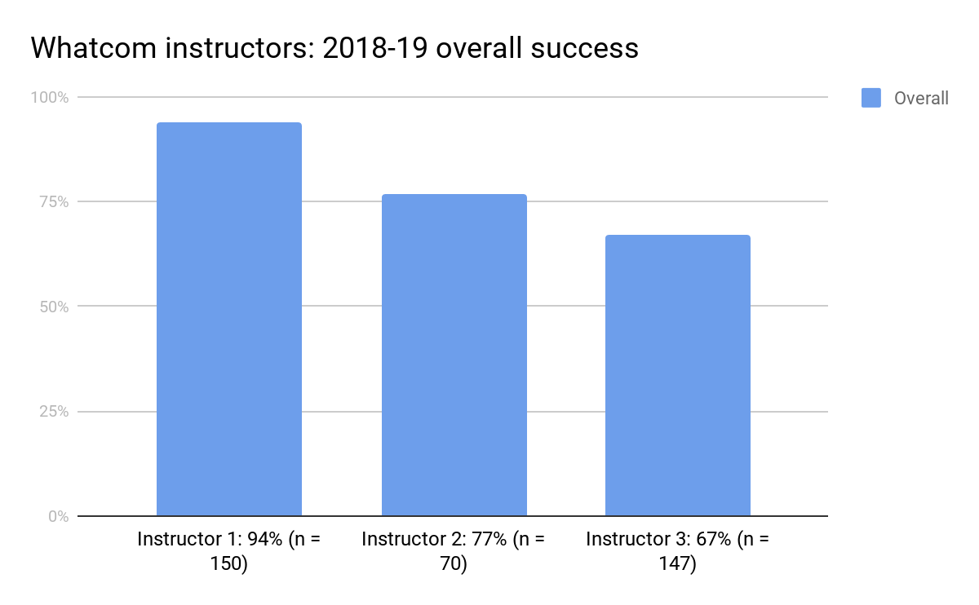
ENGL&101 is different with different teachers

Slide 21
How do we account for all these differences?
A few programmatic factors:
Access (placement, sequence), curriculum, assessment methods
Instructor training, workload, practices
Modality
Time of day
Working conditions (computer labs, office space, etc.)
Support structures: ALP, wrap-around support, etc.
Student cohorts
Make up of faculty (race, gender . . .)

Slide 22
What else factors in to these differences?
A few demographic factors:
Race
Ethnicity
Disability
Socioeconomic classes
Neuro-normalcy
Age
Gender
PT/FT
Working/not . . .

Slide 23
Disparate impact
“Even facially neutral acts, without the intent to discriminate, which ... discriminate on the basis of sex, race, gender or other protected class are prohibited.”
Department of Justice “Dear Colleagues” letter, 2014
Notes:
See Department of Justice “Dear Colleagues” letter:https://www.justice.gov/crt/file/883771/download; also see Poe and Cogan, “Civil Rights and Writing Assessment”: http://journalofwritingassessment.org/article.php?article=97. From the Title VII of the 1964 Civil Rights Act; the “Dear Colleagues” letter of 2014 extends Title VII to public education. This means that if Latinx students place into &101 at a rate lower than white students, then either we must (1) prove that the placement discrepancy identifies a necessary skill or (2) change or eliminate the practice.

Slide 24
Our goal: Equitable access to an equitable ENGL&101
Equitable access
Every student who has a reasonable chance to succeed in ENGL&101 has access to ENGL&101 ; for others, as rapid access as possible.
Equitable &101
Every student who has a reasonable chance to succeed in ENGL&101 succeeds at that rate; e.g., if we admit 100 students who have a 70% chance of success, we should see a success rate of 70%.
Notes:
But why 70%? Why not 75% or 80%?

Slide 25
Our goal
In real terms?
Access: 90%+ of all students place into ENGL&101 or equivalent? (Up from current numbers . . . 96% to 35%?)
How: Through placement reform . . . program/sequence reform . . .
Success: 85% success overall and for all demographic groups (up from current 77% overall statewide non-HUSOC and 69% for HUSCO in 2018-19)?
How?
Notes:
Reading and processing … wrapping my mind around ….

Slide 26
Equity work and antiracist work
Equity works on creating pedagogical environments that allow those traditionally marginalized students to "appropriate (or be appropriated by)" (in Bartholomae's famous words) the traditional, single-standard discourse of the academy. In other words, equity work are strategies by which traditionally marginalized students can "reach the center." Reading Apprenticeship is like this--helping students gain access to the reading habits of the academy but not addressing the racialized nature of those habits.
Antiracist work, on the other hand, is about working against the norming tendencies of the academy with an “anti” force to create space for a variety of racially-formalized ways of knowing and being. In other words, anti-racist work is about changing the academy to be open to students where and how they are, rather than helping students access the academy. Labor-based grading contracts are like this—allowing students to work on the discourse of the academy, for example, but judging them based on their work, not on the standard of academic discourse.

Slide 27
Believing & believing game

Slide 28
Believing and believing game
The doubting game represents . . . the disciplined practice of trying to be as skeptical and analytic as possible with every idea we encounter.
The believing game is the disciplined practice of trying to be as welcoming or accepting as possible to every idea we encounter: ... actually trying to believe them.
Believing comes first . . .

Slide 29
Ground rules
Work with a partner, sit side by side.
Choose a “Propositions” to consider (everyone has two pairs of propositions)
Take turns: Partner A is the speaker/believer; Partner B is the listener/believer.
Partner A: Read the first proposition of the pair and then explain to your partner why it is “true”-- “This is true because . . .”
Partner B: Listen and ask questions: Why do you believe that? What else is true about that?
After 3-5 minutes, when the bell rings, switch roles. Turn to face the opposite direction.
Partner B: Read the second of the pair and try to believe it . . . “This is true because . . . Partner A: listen and help the believer!
When you’re finished, there’ll be a debrief.
Notes:
JEN TAKES OVER: Remind! This will be difficult! Cognitive dissonance!

Slide 30
Propositions I
Our higher-education system is highly classist and racist and rewards “people like us” (sic): white, middle- and upper-class, with “standard” language skills, and seeped in the Enlightenment principles of the predominance of (cool) reason and the belief in individual autonomy: the system is rigged for “us”.
What our higher-education system strives for, if not wholly based on, are the universal and neutral principles of reason and meritocracy, where language is a neutral purveyor of reason: while not perfect, the system is better than any alternative.
Notes:
TWO PROPOSITIONS AT EACH TABLE . . .

Slide 31
Propositions II
This system is often invisible to us and acts like a mind “set” (an often unconscious way of approaching a problem) which predisposes us to see the equity gap as indicative of a deficit of students rather than as indicative of wrongly punished difference.
The system, being nearly neutral, identifies deficits that actually exist, through no fault of the students themselves, but which deficit we must help students overcome (cf. “wrap-around support,” Guided Pathways, Accelerated Learning Programs, tutoring and writing centers, etc.).
Notes:
WOAH. This is amazing. And yes … you’ve nailed it here. At the end of the day, that is what is GP is … that’s the camp it belongs in. MIND BLOWN.
ALthough … here in WA, I know JAn’s vision is that we are doing GP with an equity lens/framework-- to rebuild our structures away from being deficit producing and towards being equity producing. We are identifying the equity gaps and rebuilding our structures not to identify deficit but to see our mindsets and then change our structures … or change the structures to create new mindsets. It’s tricky. I’m finding myself wondering how Betsy Hasegawa would respond to this slide.
I’ve been trying to articulate this in my GP webinar series-- that GP, in its early years, was NOT specifically about equity in this way. But here in WA, GP is about rebuilding our colleges to acknowledge opportunity gaps, remove barriers … and not recreate opportunity gaps. And I know the college spark folks are funding this because their work around equity has shown you change the structures first.

Slide 32
Propositions III
Our standards of assessment (“clarity and correctness,” “depth of thought”) are not neutral but indicative of cultural (and racist) norms, deeply implicated in our cultural histories; these inherited standards appear neutral but shape our perceptions of reality, forming invisible biases.
Such things as “clarity and correctness” are neither racist nor cultural; language and reasoning are independent of individuals and exist irrespective of who is employing them; clear language and good reasoning reveal reality--or at least give us the best chance of knowing it--not distort it.
Notes:
AMAZING

Slide 33
Propositions IV
Our policies of attendance and late-work are part of an assessment system (an “ecology”) that privileges some cultural norms (e.g., individualistic v. collectivist) and do not enhance or assess student learning but only enforce student compliance and acquiescence.
Our policies are necessary to ensure that all students are treated equally and, thus, fairly; moreover, they ensure that students learn the habits (of mind, of body) that our world rewards; far from compliance, students are demonstrating responsibility.
Notes:
YES!

Slide 34
Propositions V
We can change standards and maintain rigor, thereby improving the learning for all students (it’s not a zero-sum game): for example, moving away from assessing students’ performance of “correct” English to rewarding students’ work in studying language differences: It’s our job to recognize and value difference.
We must teach, and thus assess, standards of critical thinking, language use, and form (i.e., genre, e.g. “the academic essay”) because, like it or not, our students will be judged by just these standards: when they transfer to UW or get a job, i.e., in “the real world”: It’s our job to prepare students to meet the expectations of society.
Notes:
WOAH.

Slide 35
Propositions VI
We can change our practices to better accommodate systemically non-dominant students and thereby improve the learning for all students (it’s not a zero-sum game): flexible attendance policies, transparent assignment design, labor contracts. These recognize different kinds of strengths.
We must have a single standard of practice for all students if we do not want to unfairly punish some and reward others (and thus demotivate some students); such standards exist in the world and indicate value, and we can’t pretend otherwise.
Notes:
Jeff, this is amazing. I am so excited to discuss this with you later today!

Slide 36
Propositions VII
While race and class overlap, race is the only one that “cannot be erased”; moreover, the power that focusing on race has to make us uncomfortable can motivate us to make changes we might otherwise not, confront tendencies we might wish to ignore, and make changes which ultimately improve learning conditions for all people, of all races, classes, genders, etc.
Equity gaps are really about class--not race: people with wealthier and more educated parents have had greater access to educational opportunities; consequently, focusing on race is unnecessarily divisive; we’d get further along if we left race out of it and focused on economic divides.
Notes:
There is an amazing podcast episode that uses longitudinal census data to prove that race “cannot be erased.” I have been trying to find it again …

Slide 37
Reflection and ways forward . . .
Journaling and freewriting . . .
Dear Self:
I used to think . . .
And now I (still) think . . .
Which makes me feel . . .
So now I can . . .
So now I will . . .

