Slide 1
(de)Composing ENGL&101 “Equitable access to an equitable 101”
South Seattle Community college, georgetown
Seattle, Washington
November 8, 2019

Slide 2
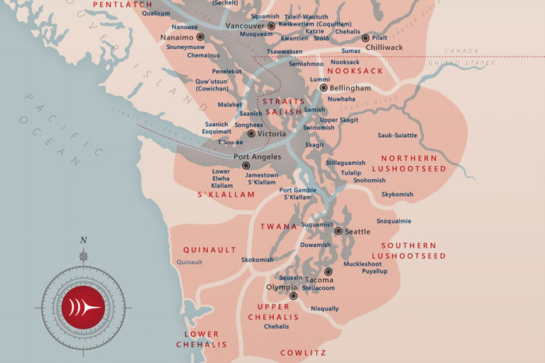
Acknowledgement
I’d like to start the day with the acknowledgement that we are on the unceded territory of the Coast Salish Peoples. They cared for the lands that cover much of what we now call the Puget Sound region, Vancouver Island, and British Columbia for millennia. I hope you will join me in expressing the deepest respect and gratitude for our indigenous neighbors, the Suqaumish, Muckleshoot, and Puyallup, for their enduring care and protection of our shared lands and waterways.

Slide 3
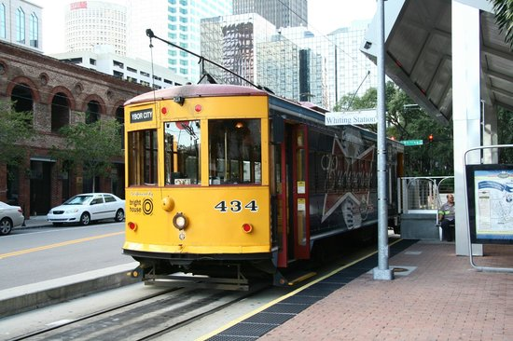
dc&101 by the numbers
2
The number of conversations Jen Whetham had at the 2015 CCCC in Tampa about the need to form a group to work on ENGL&101 across the state
7
The number of meetings of state faculty that resulted from Jen’s discussions
32
Colleges represented by faculty attending some or all of these meetings
6
The number of learning outcomes in the new statewide recommended (but not mandated!) learning outcomes

Slide 4
dc&101 by the numbers
8
The number of sessions over two years dedicated to discussing learning outcomes
355
The greatest distance in miles traveled to attend a meeting (Spokane to Vancouver)
220
The number of box lunches consumed during these ENGL&101 meetings
56,884
The number of students who enrolled in ENGL&101 in 2018-19 in Washington 2ycs

Slide 5
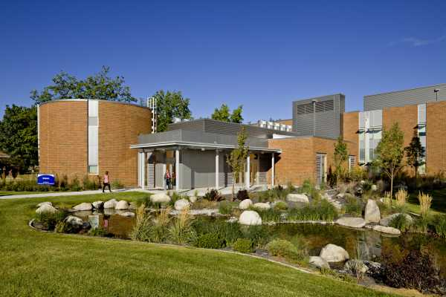
Convening . . .
2015 Fall Spokane Falls CC English 101 as “Next Space” with Kathy Yancey
2017 Fall Olympia @ SBCTC Pathways In, Pathways Through, Pathways Out
2018 Winter Evergreen State Where Are We Going, Where Have We Been?
2018 Spring Central Washington Where Are We Going, How Do We Get There?
2018 Fall Clark College Collectively Creating an Equitable ENGL&101
2019 Winter Whatcom Collectively Creating an Equitable ENGL&101, Part II
2019 Spring Yakima Valley Equitable Access to an Equitable &101: Pathways In, Through, and Out
2019 Fall South Seattle
Pictured: Spokane Falls CC

Slide 6
emerging goal
equitable access to an equitable 101:
pathways in, pathways through, pathways out

Slide 7
challenge
equal
a single standard or practice that yields equal opportunity for all students
equitable
a system or practice that yields equal results for all students
Spokane Falls, fall 2015

Slide 8
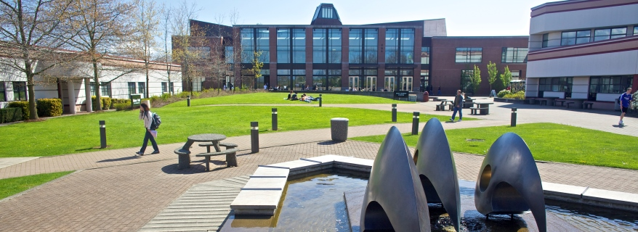
challenge
directed self-placement at Whatcom . . .
1280 students who self-placed into English classes in 2018-19
94 percent of all in-coming students who self-placed into college-level English
84 percent of latinx students who self-placed into college-level English
84 percent of black who self-placed into college-level English
Whatcom, winter 2019

Slide 9
challenge
success rates in 101 at Whatcom
79% of white students succeeded in English 101 prior to dsp
81% of white students succeeded in 101 since dsp
59% of black students succeeded in English 101 prior to dsp
81% black students succeeded in 101 since dsp
67% latinx students succeeded in English 101 prior to dsp
66% latinx students succeeded in English 101 since dsp

Slide 10
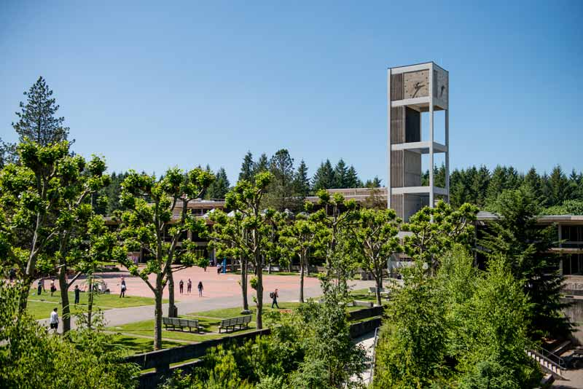
challenge
why the equity gap for latinx students in 101?
it's about students’ readiness for college-level classes. . . so, adjust placement
it's about the readiness of practitioners for varied students . . . so, adjust our practices
Evergreen State, fall 2017

Slide 11
challenge
past five years
our highest-performing regular instructor . . .
92 percent of students passed ENGL&101
our lowest-performing regular instructor . . .
62 percent of students passed ENGL&101

Slide 12
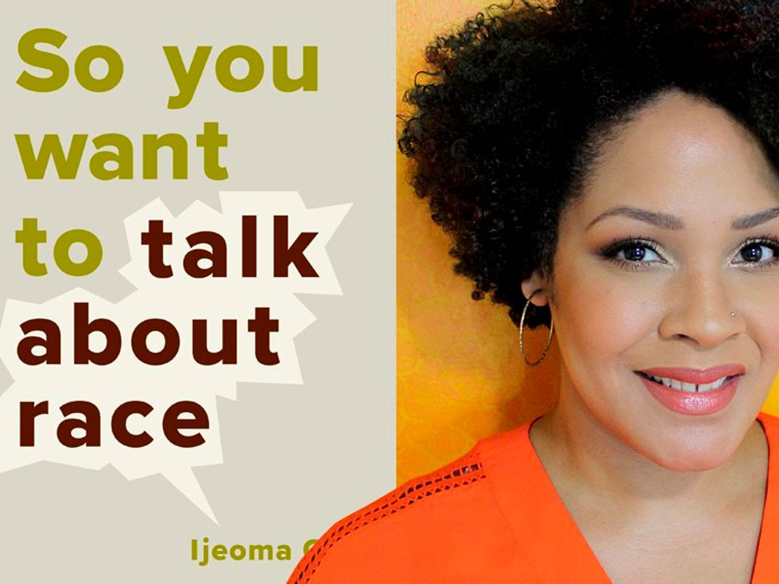
equitable
“It is about race if it disproportionately or differently affects people of color.”
Ijeona Oluo So You Want to Talk about Race

Slide 13
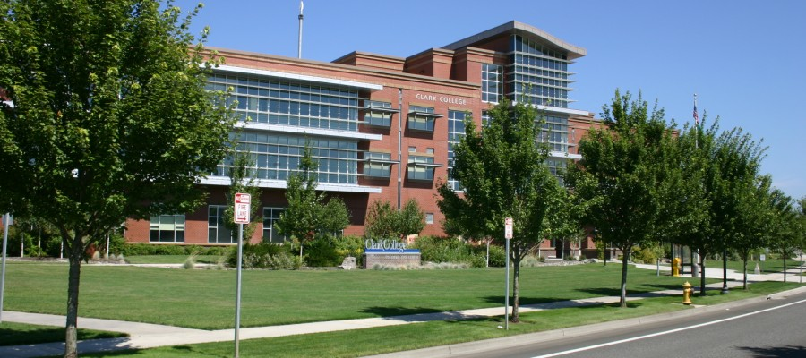
strategies
pathways in pathways through pathways out
Placement Learning outcomes Assessment principles
Dev Ed Accelerated models Anti-racist writing assessments
Data uses Reading strategies Data uses
College readiness Multimodal composing Social justice artifacts
Podcasting
TILT
Teaching for transfer
Inclusive pedagogy
Clark College, Columbia Tech Center, fall 2018

Slide 14
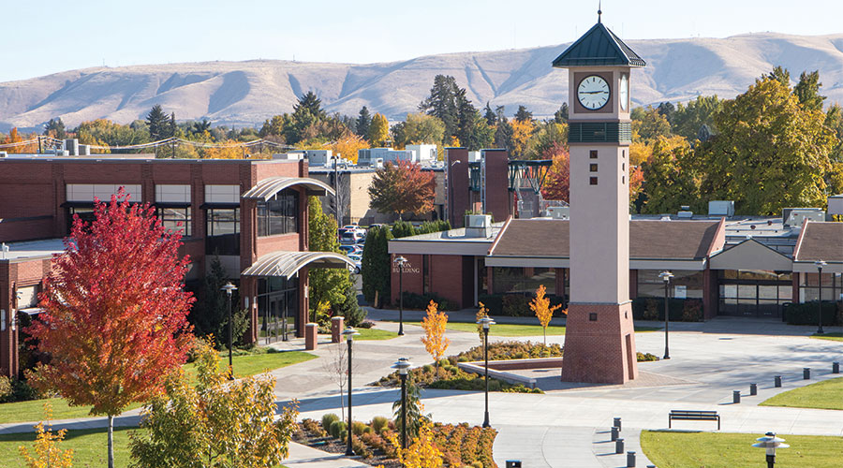
successes
placement reform spreading across the state
learning outcomes adopted as recommended
learning outcomes revised at individual campuses
greater awareness of equity gaps
greater appreciation of need for data to inform decision making
greater awareness of opportunities for strategic reform
Yakima Valley College, Spring 2019

Slide 15
challenge
learning outcomes and equity
functional literacy: the ability to read, write, think, and communicate within the demands of the institutional context; e.g. “academic discourse”; i.e., “we teach students to function in the academy”
critical literacy: the ability to identify, critique, and thus resist hegemonic discourse patterns, whether sexist, racist, or classist; e.g. “critical discourse”; i..e., “we teach students to critique and resist the hegemonic impulses of the academy and the larger cultural context (sexist, racist, classist, homophobic, ableist) which constitutes and enables it.”

Slide 16
challenge

Slide 17
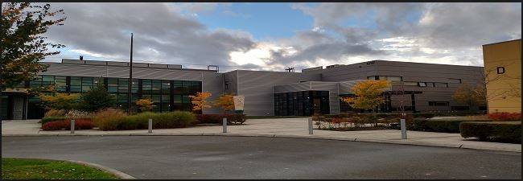
what’s next
further placement reform . . . share data and experiences
explore culturally sensitive pedagogies . . . share knowledge and resources
implement anti-racist writing assessment . . . share practices and artifacts
examine systemic inequities . . . share insights and practices
South Seattle College, Georgetown, Fall 2019

Slide 18
(still) reachable goal
2015 “fyc in 2020”
2020 “equitable access to an equitable 101”

