Slide 1
Assessment and the Equitable English &101
Changing the Paradigm
Courtney Edwards (Pierce College), Jeffrey Klausman (Whatcom Community College), Candace Morrow (Olympic College), and Ian Sherman (Green River College)

Slide 2
The Basics: Key Terms and Concepts

Slide 3
How can assessment practices help to create a more—or less—equitable ENGL&101?
At the course level?
At the program level?
Questions and Discussion
Notes:
Use this slide for table discussions and for share outs

Slide 4
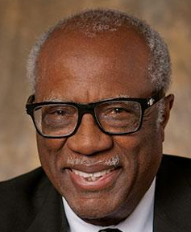
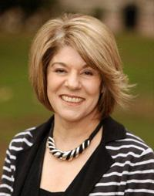
Framing Equitable Practices
James A. Banks
Estela Mara Bensimon

Slide 5
Applying the Framework: Equitable Practices in English &101

Slide 6
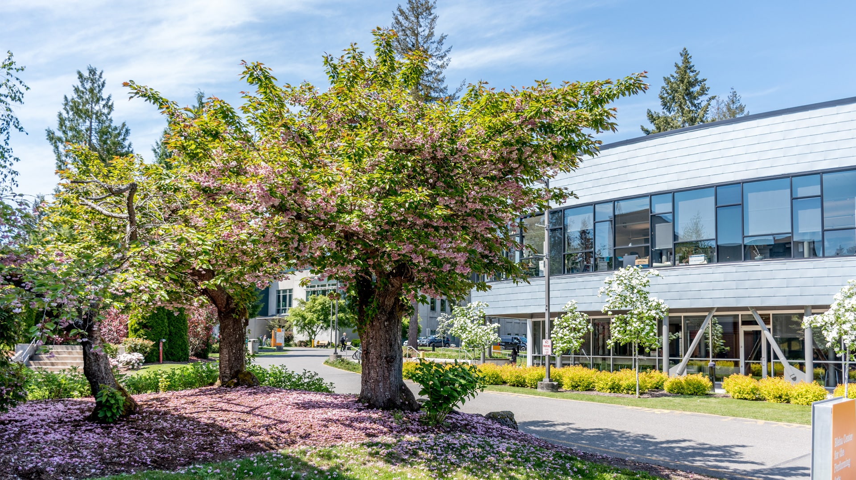
Examples from the Field: Green River College

Slide 7
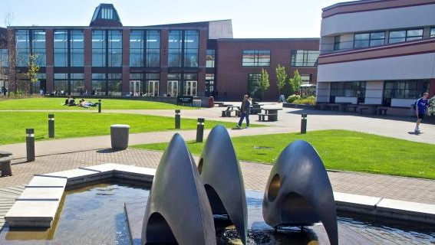
Examples from the Field: Whatcom Community College

Slide 8
Whatcom Assessment: Pedagogical Practices
Roundtable with students and exemplary faculty: What do some very successful faculty do to foster success in their classes?
Transparency in Teaching and Learning: How close are we to 100% adoption for transparent assignment design and how might we get there?

Slide 9
Whatcom Assessment: Pedagogical Practices
Grading contracts: What can we learn from our efforts and how can we improve and expand use?
Artifact assessment: What do our syllabi, grading rubrics, class policies (late work, missing assignments, attendance) “say” when seen through an anti-racist assessment lens?

Slide 10
Reflection, Planning, and Further Questions

