Slide 1
Bridge to College English Podcast:
The BRIDGE
Justin Ericksen, Whatcom CC
Andrea Reid, Spokane CC

Slide 2
Talking Points
Reminder--Bridge to College English and 101
Context--podcast is modeling Yancey’s ideas of new composings and “a peer co-apprenticeship in which communicative knowledge is freely exchanged” (5)
Information--about the podcast
How you can be involved!

Slide 3
IN THROUGH OUT
ENGL&101 Paths
Notes:
We did some work around this at our first 101 meeting: High school
HS (Common Core State Standards)
In different ways, Smarter Balanced Assessment
Basic Ed for Adults / English Language Learners College and Career Readiness Standards for Adult Education: https://lincs.ed.gov/publications /pdf/CCRStandardsAdultEd.pdf English Language Proficiency Standards for Adult Education: https://lincs.ed.gov/publications /pdf/elp-standards-adult-ed.pdf
AND

Slide 4
Bridge to College Website
bridgetocollegecourses.org

Slide 5
Bridge to College
Bridge to College transition courses offer qualified high school students a unique way to gain the skills and knowledge they need to graduate ready for college-level courses in math and/or English.
If they plan to go straight to college after high school, successful completion (B or better) of Bridge to College courses can save these students time and money by avoiding the need to take pre-college classes when they enter participating higher education institutions in Washington (all community and technical colleges plus Eastern Washington University).
(College Spark Washington)

Slide 6
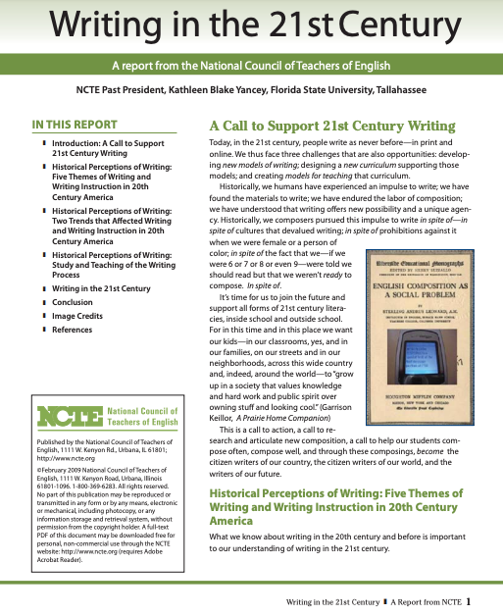
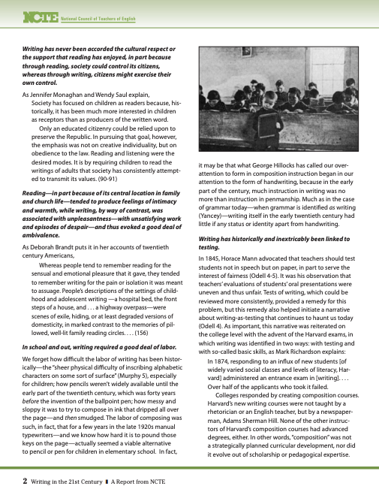
2. Context

Slide 7
NCTE report “Writing in the 21st Century”
“...one of the biggest changes is the role of audience: writers are everywhere but so too are audiences”
“...our impulse to write is now digitized and expanded—or, put differently, newly technologized, socialized, and networked.”
“...less of a hierarchy of expert-apprentice, but rather a peer co-apprenticeship in which communicative knowledge is freely exchanged”
(Kathleen Blake Yancey)
http://www.ncte.org/library/NCTEFiles/Press/Yancey_final.pdf

Slide 8
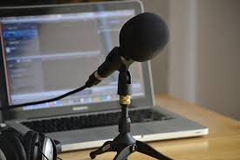
3. The BRIDGE Podcast
[Photo credit: www.nicolassolop.com].

Slide 9
The BRIDGE Podcast
The BRIDGE is a podcast created by teachers, for teachers, which highlights the work happening across the state of Washington in Bridge to College transition courses. The BRIDGE supports the fundamental mission of the courses by examining how we best prepare students for college.

Slide 10
The BRIDGE Podcast
Each month, we explore a different problem of practice in the English classroom and interview established Bridge to College teachers to share their stories as well as practical, creative strategies for addressing those problems of practice.
In order to get a fuller picture, we also bring in student stories and higher education faculty voices to round out our collective inquiry into how Bridge to College supports student success in the transition from high school to college.

Slide 11
The BRIDGE Podcast
Episode 1: Get to Know Bridge to College English
Episode 2: Problems of Practice in the Classroom
Episode 3: Building Bridges between High School and
Higher Ed
Episode 4: SPECIAL ENGL&101 EDITION!

Slide 12
How to get involved today
READ--THINK--SHARE your opinion about the Chronicle article about your reading practices in English 101
THINK--SHARE what you want students to know about English 101
COME GET RECORDED! Individually or in pairs
*Throughout the lunch hour & until 2:00
*In the ______________ room
Notes:
"what is the number one thing you want incoming 101 students to know about your class?"
"what is your favorite thing about teaching English 101?"
"what is the value of English 101 for students? Why should they come take your class?"

Slide 13
Search on Soundcloud for Bridge to College Podcast
Or access at https://soundcloud.com/greyareaissues

