Slide 1
The Dynamic Uses of Common Outcomes
Courtney Edwards, Pierce Jamie Jones, Grays Harbor Jeffrey Klausman, Whatcom Travis Margoni, Yakima Elisa Parrett Lake Washington Heather Ryan, Wenatchee Valley

Slide 2
Overview of session
Where we’ve come from . . . . .
Defining terms . . . . . . . . . . .. . . .
Outcomes in action: What can outcomes do? . . . . . . . . . . . . . .
Adopting shared outcomes? . .
Looking ahead: Outcomes and assessment in action . . . .
Jeff and Travis 2:15-20
Elisa and Courtney 2:20-2:50
Courtney, Elisa, Jamie 2:50-3:20
Travis and Jeff 3:20-3:35
Courtney et al. 3:35-3:45

Slide 3
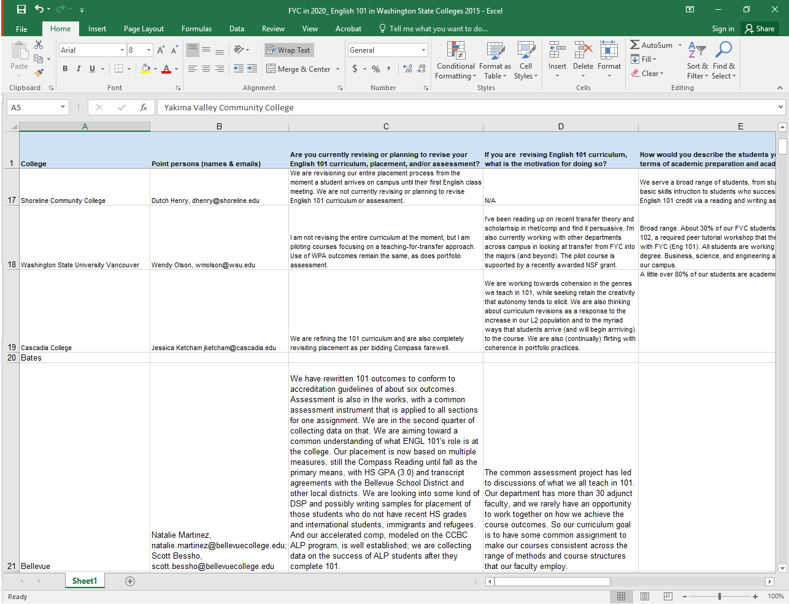
Where we’ve come from Spokane 2015 @ Spokane Falls CC
Q: What reforms are currently underway or being considered for ENGL&101 and where do outcomes fit?
Shared Google Doc: 25 respondents
WPA Outcomes explicit or implicit in many
Reform also widespread and disparate

Slide 4
Where we’ve come from February 2018 @ Evergreen
Q: How do English 101 outcomes support social justice? How might a shared set of 101 outcomes facilitate change on our campuses?
Compared outcomes on our campuses: overlap and outliers
Brainstormed a set of learning outcomes we could live with
Called for a group to draft a set of outcomes from session ideas
Volunteers developed a draft set of outcomes with rationale from notes

Slide 5
Where we’ve come from May 2018 @ Central Washington
Q: How might shared outcomes be a foundational piece for facilitating social justice through curricular and assessment reform?
Shared what outcomes are currently doing on our campuses and found that outcomes are often only shared document, so used in a wide variety of sometimes ineffective ways
Everything “dumped in”
23 course outcomes, many non-measurable
Used to “control” especially contingent faculty, etc.

Slide 6
Where we’ve come from May 2018 @ Central Washington
We also found a shared sense of what outcomes can do is implicit: we can “hack” outcomes to “create rich environments for student success and promote social justice.”
We reviewed draft of shared outcomes and offered suggestions for revision.
The team incorporated the revisions to create “Recommended Learning Outcomes”

Slide 7
Where we are today November 9 @ Clark
Session goals: What outcomes are and what outcomes can do
Sharpen our understanding of key concepts of outcomes
Consider what outcomes can do for us—explicitly—going forward
Look at our shared outcomes . . . adopt?
Look ahead to linking outcomes to assessment (winter @ Whatcom)

Slide 8
Up next
Defining terms . . . What are we talking about when we talk about outcomes?
Elisa and Courtney

