Slide 1
Disparate Impact and Placement Reform: What Do the Data Show?
Jeffrey Klausman Whatcom Community College jklausman@whatcom.edu

Slide 2
Disparate impact
“We can . . . define disparate impact discrimination as the unintended racial differences in outcomes resulting from facially neutral policies or practices. . . . Because discrimination flows from the test design, process, or use of test scores, rather than from the intent of the test giver, disparate impact analysis focuses on the consequences of specific testing practices.”
Poe, M., Elliot, N., Cogan, J., & Nurudeen, T. (2014). The legal and the local: Using disparate impact analysis to understand the consequences of writing assessment. College Composition and Communication, 65(4), 588-611.

Slide 3
Question
What were the consequences of our placement practices and what effect has our reform efforts had on creating equitable access to first-year writing?

Slide 4
Placement by Accuplacer sentence-skills/reading score: 2011-14

Slide 5
African-American placement by Accuplacer: 2011-14

Slide 6
Hispanic placement by Accuplacer: 2011-14

Slide 7
Native-American placement by Accuplacer: 2011-14

Slide 8
White placement by Accuplacer: 2011-14

Slide 9
Placement by Accuplacer sentence-skills/reading score: 2011-14

Slide 10
Interpretation: prior to reform
Whites placed into FYC at twice the rate of others (46% to 23%).
Students of color placed into pre-101 courses at a much a higher rate (76-78% to 53% for whites).
Students of color subject to “pipeline” effect at a much higher rate (0% to 64% completion of ENGL&101 within three years)

Slide 11
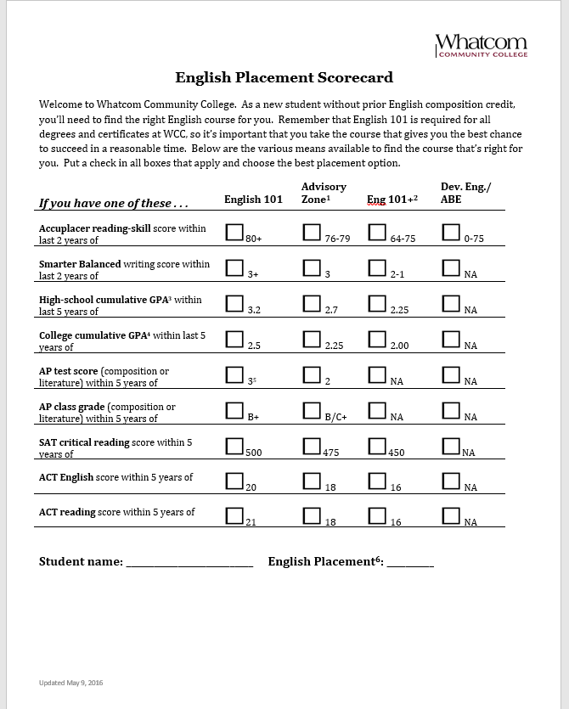
Response
Placement reform: multiple measures (options), mostly GPA
Pathway reform: 100-level lit; college-level study skills; opt-out of pipeline

Slide 12
Effect on equitable access: placement into English 101
 | Before (Accuplacer) | After (multiple measures)
African American | 19% | 81%
Hispanic | 32% | 62%
Native American | 27% | 68%
White | 48% | 85%

Slide 13
Effect on equitable access: success rates in English 101
 | Before (Accuplacer) | After (multiple measures)
African American | 71% | 69%
Hispanic | 77% | 77%
Native American | 69% | 69%
White | 82% | 84%

Slide 14
Interpretation
Accuplacer blocked students of color from first-year writing, and effectively from access to college, at significantly higher rates than whites.
Success rates show no justification for placement: success rates in 101 remained the same or very nearly the same.
Accuplacer could not distinguish between those who would be or would not be successful in English 101 among demographic groups.
Accuplacer sorted by race/ethnicity; effected disparate impact.

Slide 15
From multiple measures to informed self-placement
However, we still had an equitable access gap:
 | Placement into ENGL&101
African American | 81%
Hispanic | 62%
Native American | 68%
White | 85%

Slide 16
ISP placement: raw numbers
Number of students using ISP | 1082
Percentage of students choosing “college-level English” | 94%
Percentage of students choosing “pre-college-level English” | 3%
Percentage of students unsure, “need assistance”: | 3%

Slide 17
ISP disaggregated data to be assessed January 2019
What percentage of students enrolled in a college-level English course (101, 174, lit) first quarter?
What percentage of students enrolled in a pre-college English class (Dev Ed, ABE, ESL/ELL)?
What are the success rates in college-level English?
What are the success rates in pre-college-level English?
Future data: success rates in first-class second quarter; success rates in second English class; overall persistence, completion, and success rates.

Slide 18
In sum. . .
We looked at the data on access (the goal) and made changes to the process:
Accuplacer had a disparate impact
Multiple measures reversed placement trends of demographic groups but not between groups
Informed self-placement puts students in charge: agency
Disaggregated data available Jan. 2019

Slide 19
Driving questions . . .
How do our students gain access to ENGL&101? What do the disaggregated data show? What barriers stand in the way? How can we remove as many barriers as possible and how can we increase student agency while maintaining acceptable success rates in first class and second class?

Slide 20
References and acknowledgements
Inoue, A. B., & Poe, M. (2012). Race and Writing Assessment. New York, NY: Peter Lang.
Poe, M., Elliot, N., Cogan, J., & Nurudeen, T. (2014). The legal and the local: Using disparate impact analysis to understand the consequences of writing assessment. College Composition and Communication, 65(4), 588-611.
Scott-Clayton, J. (2012). Do High-Stakes Placement Exams Predict College Success? CCRC Working Paper No. 41. New York, NY: Community College Research Center.
.
Thanks to Anne-Marie Karlberg, Kim Struiksma, and Peter Horne of the Assessment Office at Whatcom Community College for the interactive data dashboards.

