Slide 1
(de)Composing ENGL&101
Clark college, Columbia tech center
Vancouver, Washington
November 9, 2018

Slide 2
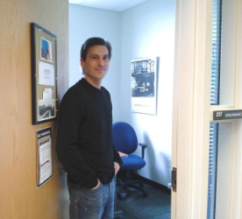
Framing the day
I have several goals in this mini-presentation
To give an overview of where we’ve come from for those new to the room
To provide a conceptual frame for the work we’re doing here today
To say something clever and inspirational that will make you think I’m smart
Jeffrey Klausman Whatcom Community College jklausman@whatcom.edu

Slide 3
Beginning: FYC in 2020
“Create a long Community of Practice (CoP) that develops a current snapshot of English&101 across Higher Education in Washington state and explores future considerations, possibilities, and revisions of 101.”
Jen Whetham, July 2015

Slide 4
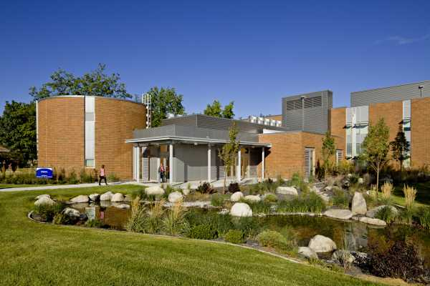
We gathered
Spokane Falls, fall 2015: FYC in 2020: English 101 as “Next Space” with Kathy Yancey
Olympia @ SBCTC, fall 2017: Pathways In, Pathways Through, Pathways Out
Evergreen State, winter 2018: Where Are We Going, Where Have We Been?
Central Washington, spring 2018: Where Are We Going, How Do We Get There?
30+ colleges represented, including two four-year institutions

Slide 5
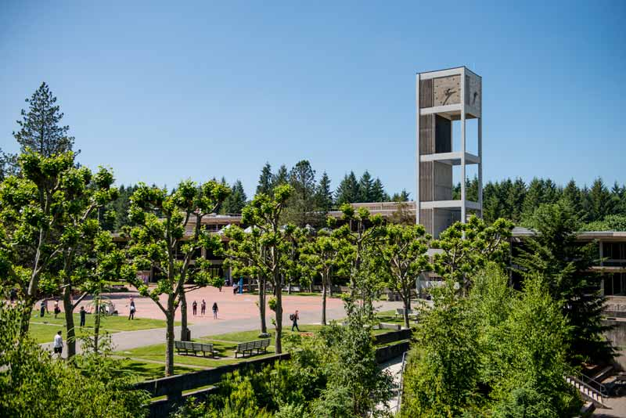
We shared overarching concerns
ENGL&101
“&” means a “common” course for every college in the system
A lot of power—every student in the system passes through
Yet, ENGL&101 is different at different places—why?
Many of us felt siloed, working in isolation, with varying degrees of support
Q: What can we, together, do to make ENGL&101 more effective across the state and how?

Slide 6
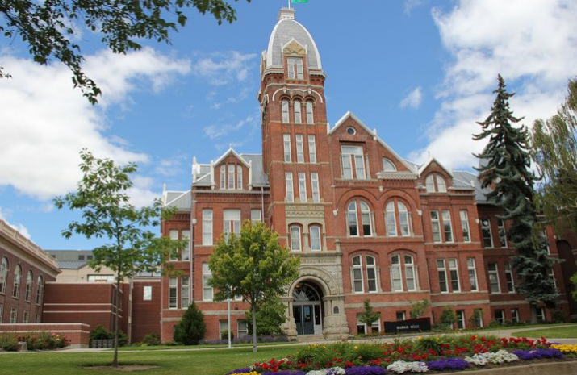
Our questions began to define us
We asked
Who has access to our classes and how?
Who does not have access, why, and why not?
Who is succeeding in our classes and who is not and why?
What does it mean, anyway, to “succeed”?
How can we support one another as we strive to reform our programs back home?
“Today’s problems come from yesterday’s solutions.”
Peter Senge
Systems scientist, MIT Sloan School of Management

Slide 7
Our responses began to shape us
Areas of interest
Placement practices
Program pathways
Learning outcomes
Writing assessment
Methods of addressing issues
Anti-racist writing assessment
Teaching for transfer
Transparency in Learning and Teaching
Inclusive pedagogy
Data collection
Successful reform efforts

Slide 8
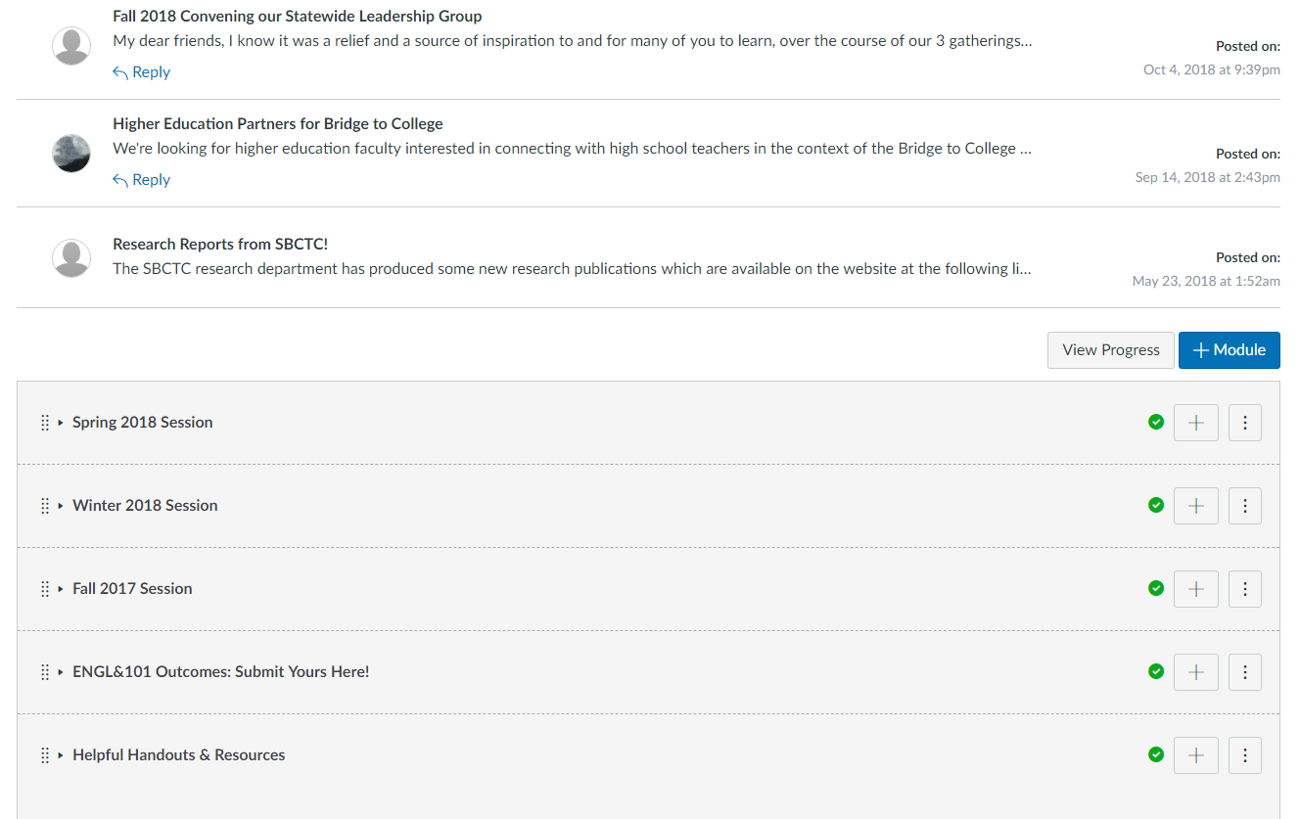
We shared resources

Slide 9
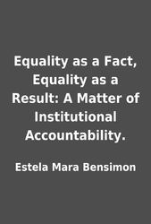
We have begun to envision a shared purpose
English 101 is the site on campus where we can do our most effective social justice work.

Slide 10
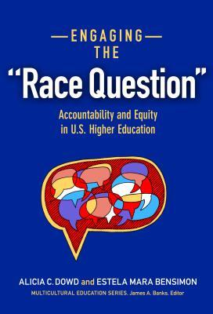
Yet this is hard work
Social forces apparently beyond our control
Systemic forces that intersect every part of campus
Differences, gaps in theory and belief across our campuses
Limited resources: funding, data
Limiting factors: labor, leadership, scholarship

Slide 11
And things keep moving
What does “college ready” really mean?
Can we really predict who will be successful?
What does a C in ENGL&101 mean? Can we accept that? Should we?
Is “literacy” really something we can measure?
Whose literacy?
“It’s easier to jump on a moving train if you’re on a moving train yourself.”

Slide 12
Karen Barad and “agential realism”
“Thingification—the turning of relations into ‘things,’ ‘entities’—infects much of the way we understand the world and our relationship to it.”
Niels Bohr, “Measurements do not represent measurement-independent states of being.”
Judith Butler, speaking of Foucault, “But the subjects regulated by such structures are, by virtue of being subjected to them, formed, defined, and reproduced in accordance with the requirements of those structures.”
Karen Barad, “Posthumanist Performativity: Toward an Underderstanding of How Matter Comes to Matter,” Signs: Journal of Women in Culture and Society, 28:3, 2003.

Slide 13
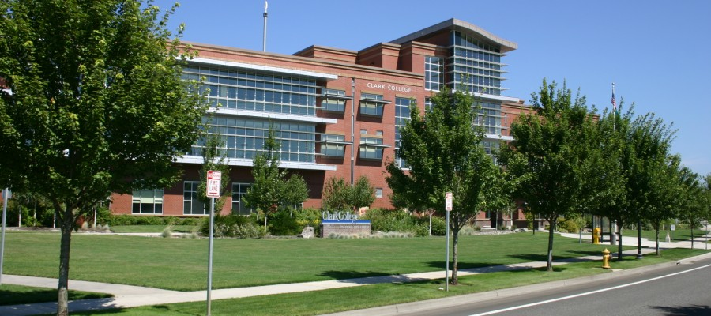
Which brings us to today
“Collectively Creating an Equitable ENGL&101”
How can we approach the teaching of reading as part of a shared equitable pedagogy?
How do we shape a placement system to create equitable access?
How can shared outcomes foster an equitable learning experience across an entire state?

Slide 14
The overarching question remains
How can we support one another in creating placement systems, programs, curricula, and pedagogies that are theoretically savvy, in keeping with other programs across the state, and honor and encourage innovation and academic freedom for all subjected to those structures?

